Slide 1
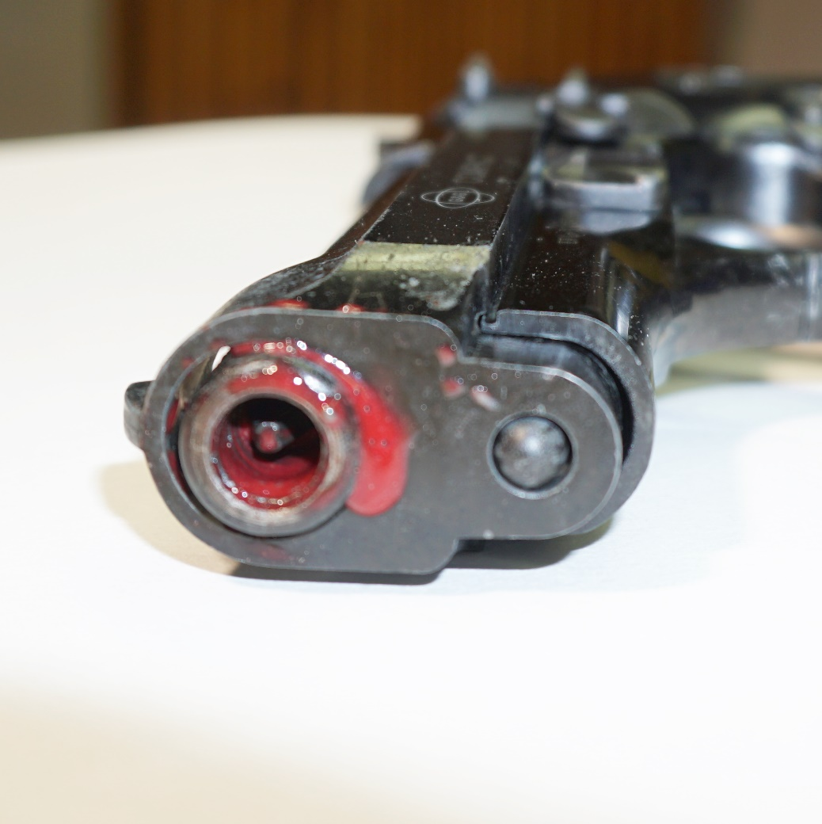
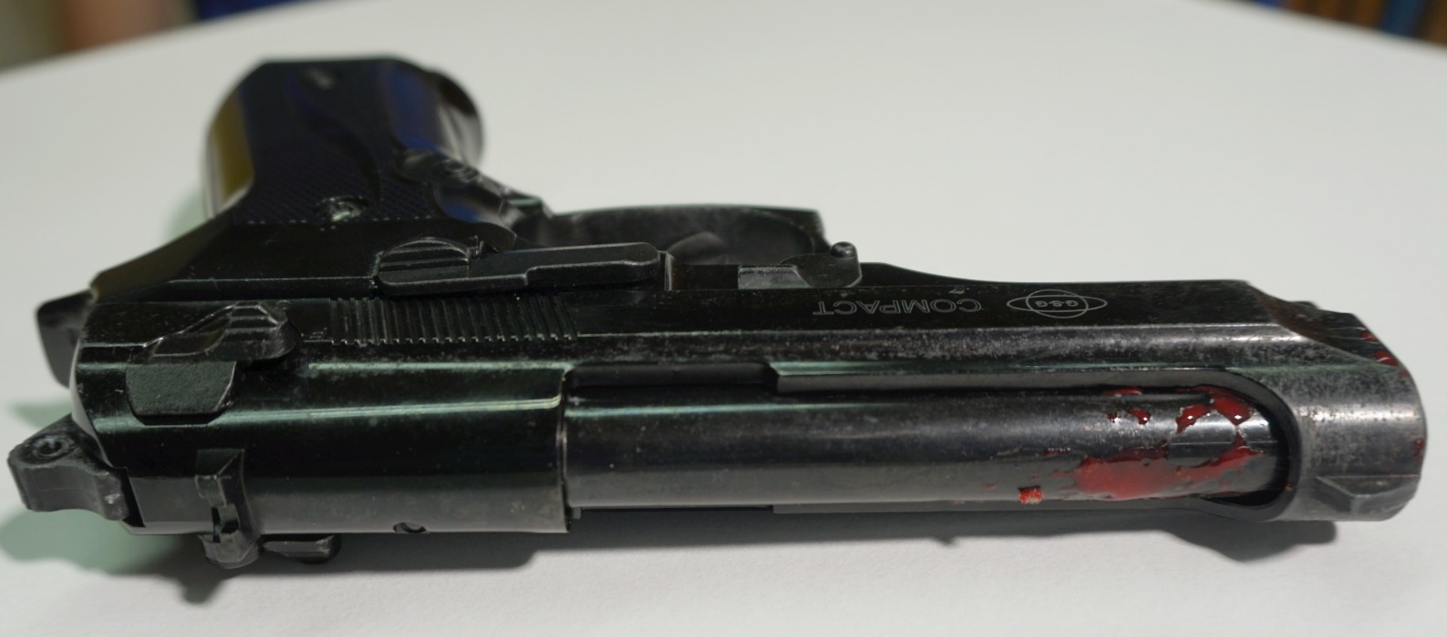
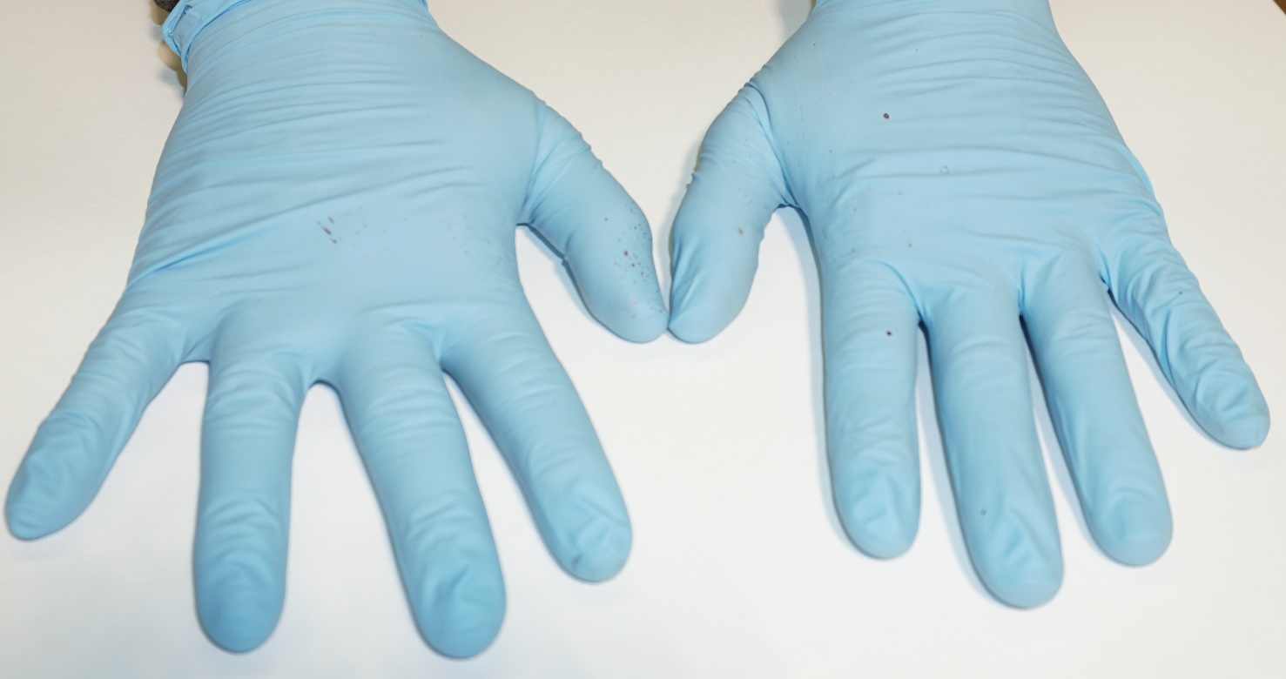
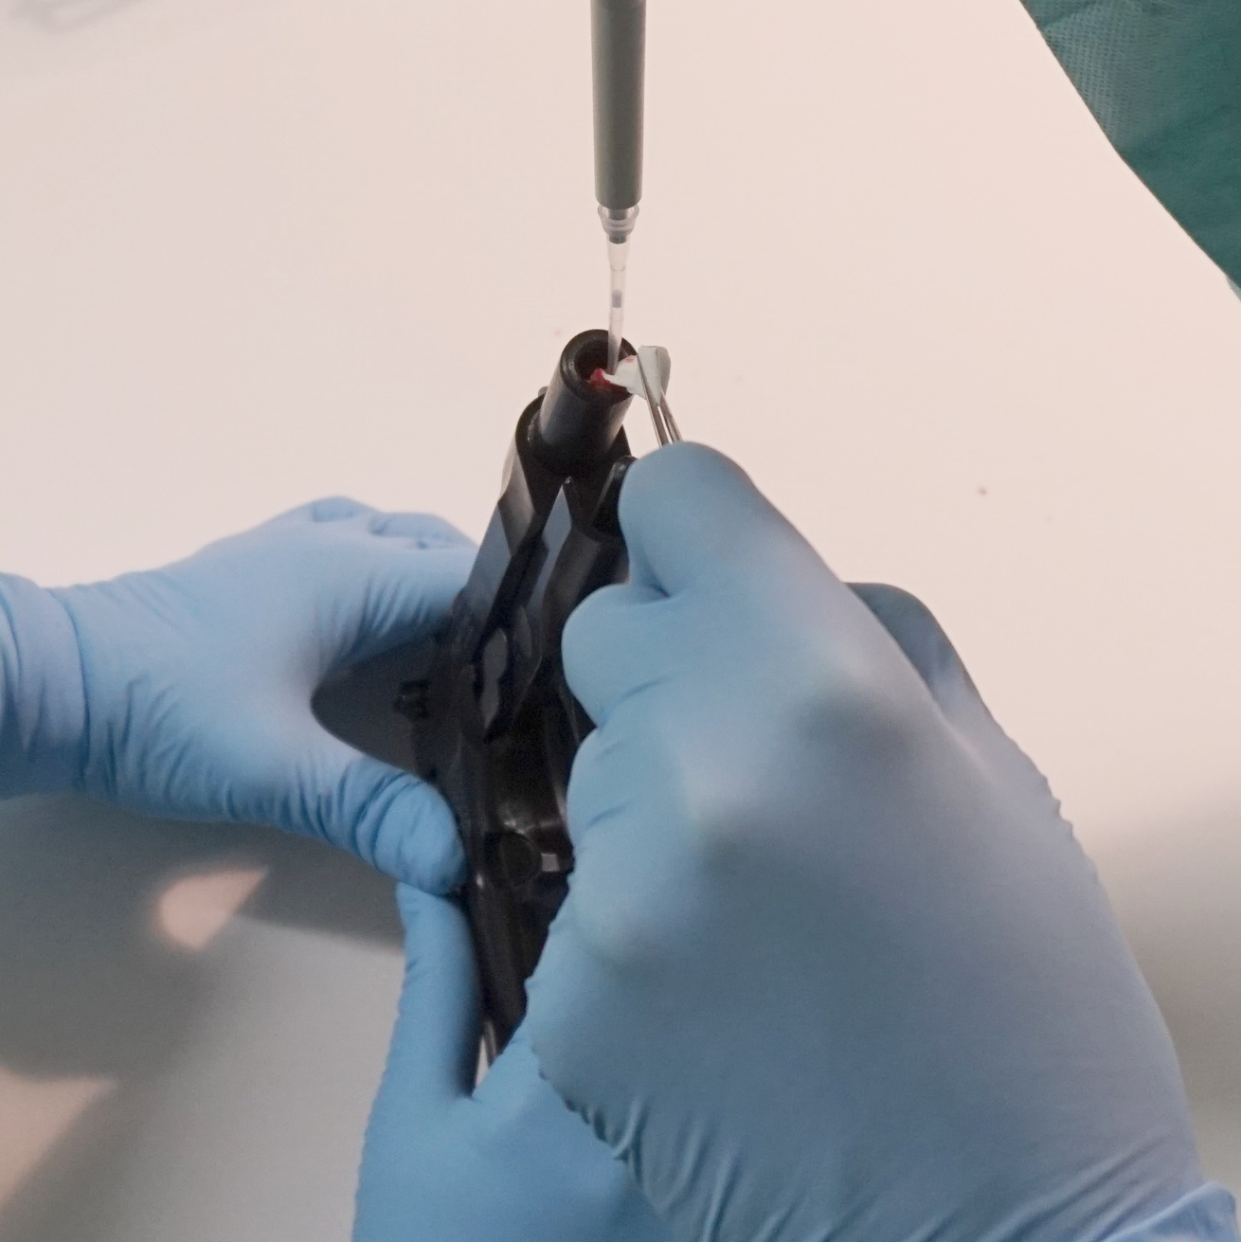
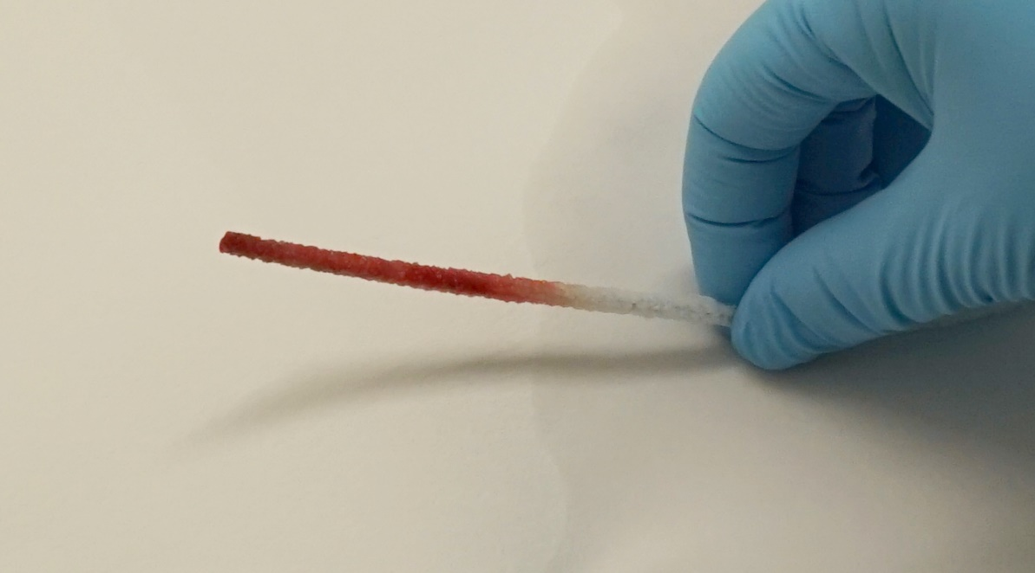
Supplementary Figure 1
A
B
C
D
E
Notes:
Supp. Fig. 1
Weapon: Ekol Firat pistol
Ammunition: Skullfire 9 mm
Model Setup: Single layer chamois leather
A: View outer surfaces, B: View muzzle/barrel, C: Hands of shooter, D: Pipe cleaner at cleaning process of the barrel, E: Sampling technique of the barrel through the muzzel

Slide 2
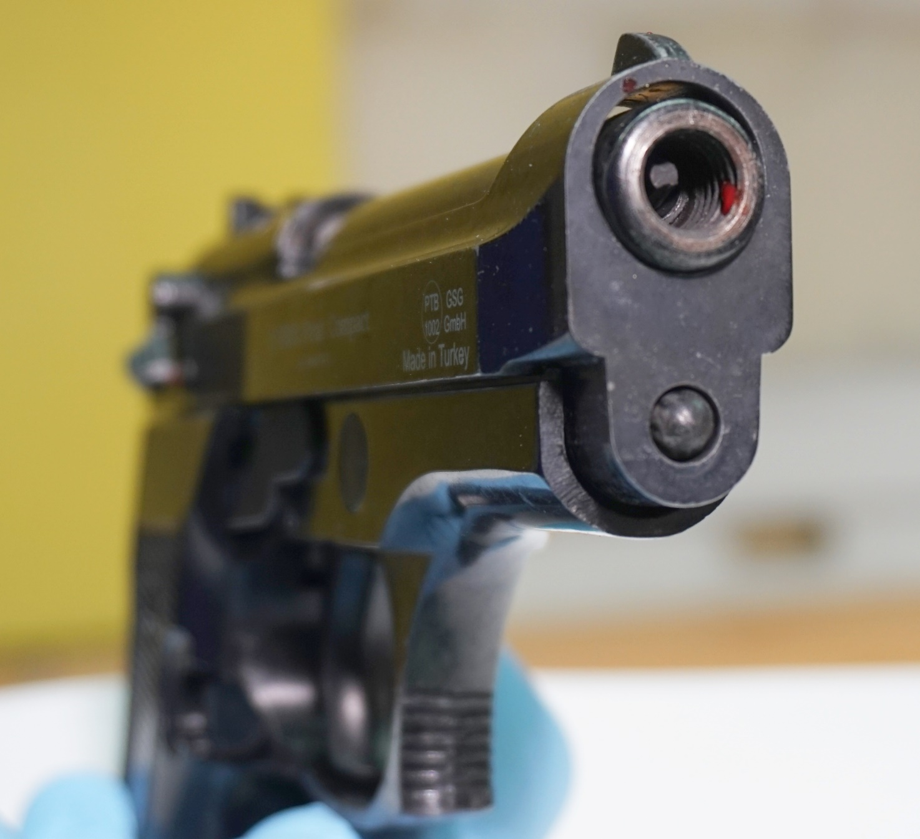
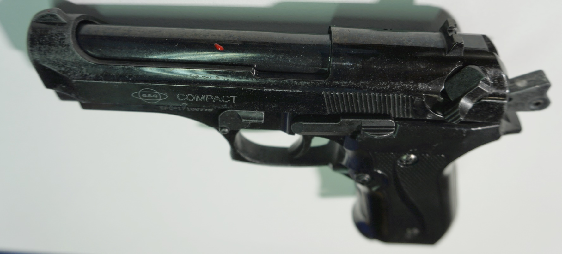
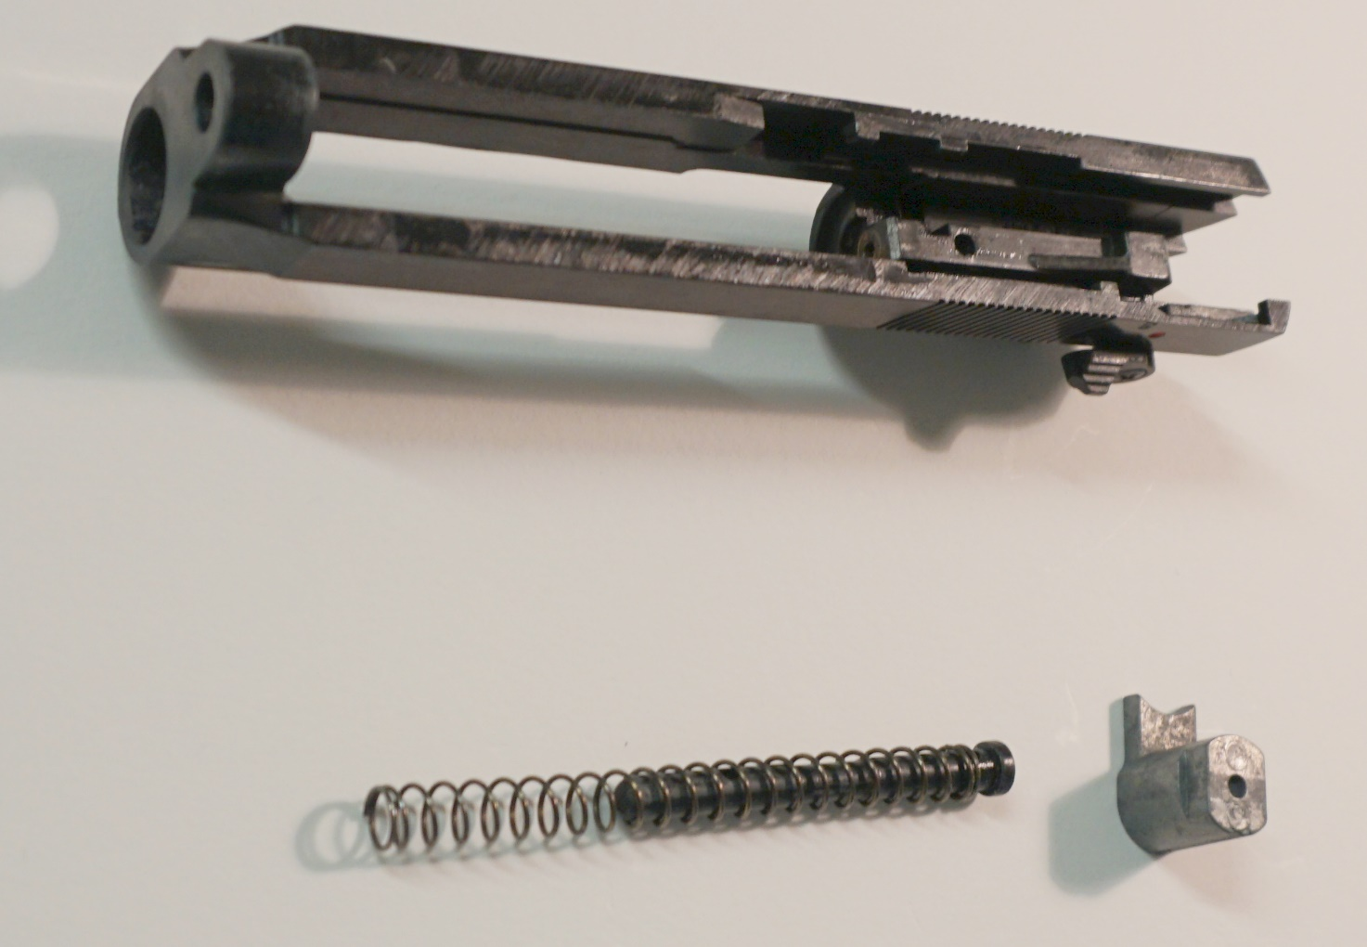
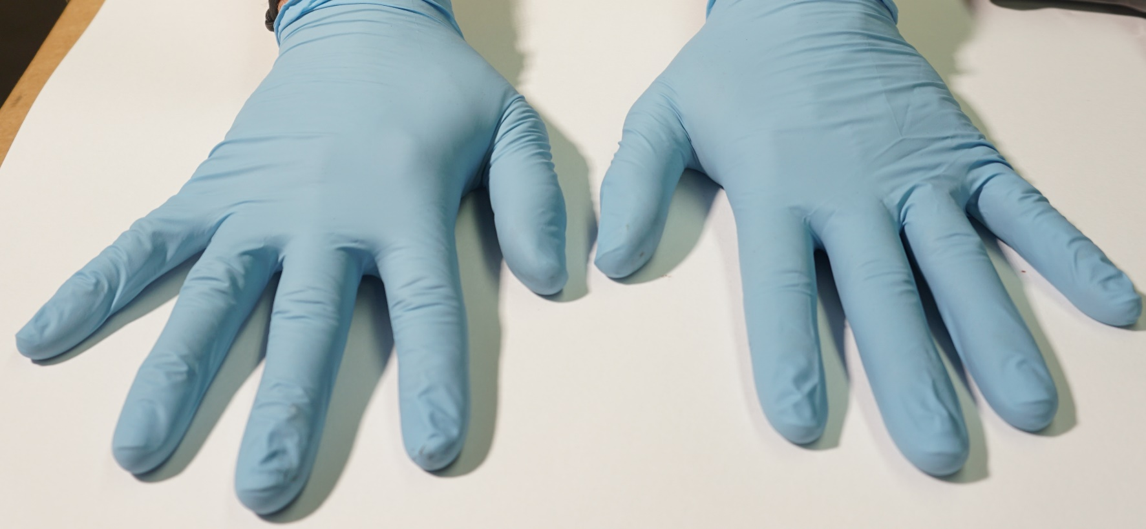
Supplementary Figure 2
A
B
C
D
Notes:
Supp. Fig. 2
Weapon: Ekol Firat pistol
Ammunition: Skullfire 9 mm
Model Setup: Double layer chamois leather
A: View Outer surfaces, B: View muzzle/barrel, C: Hands of shooter, D: Detachable parts of pistol

Slide 3
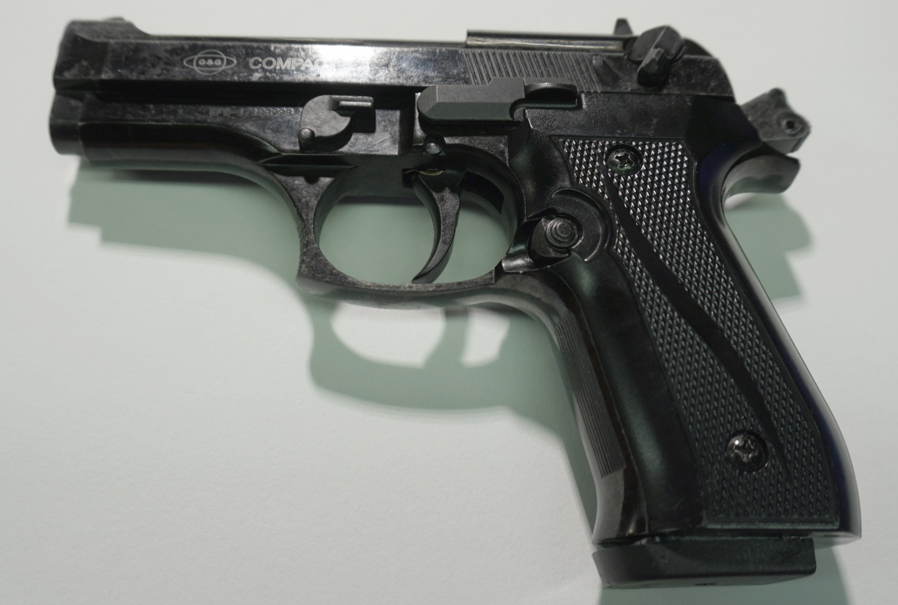
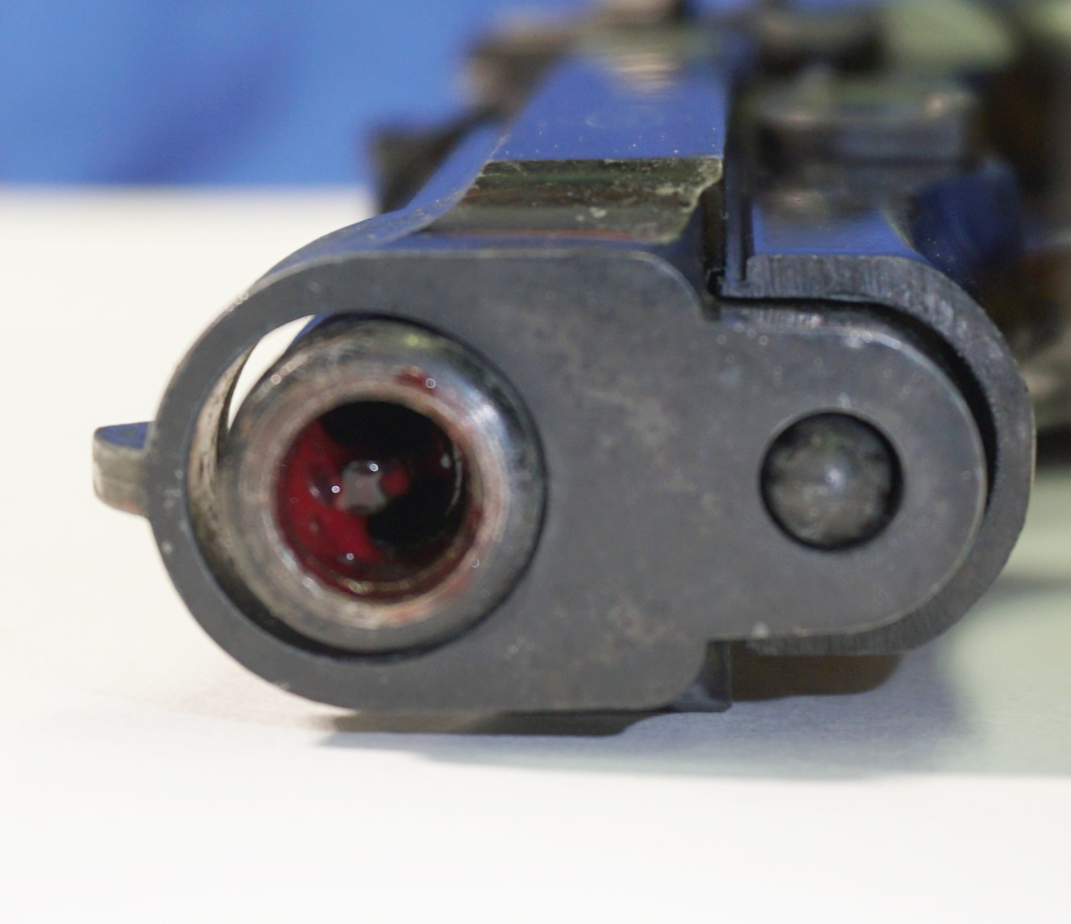
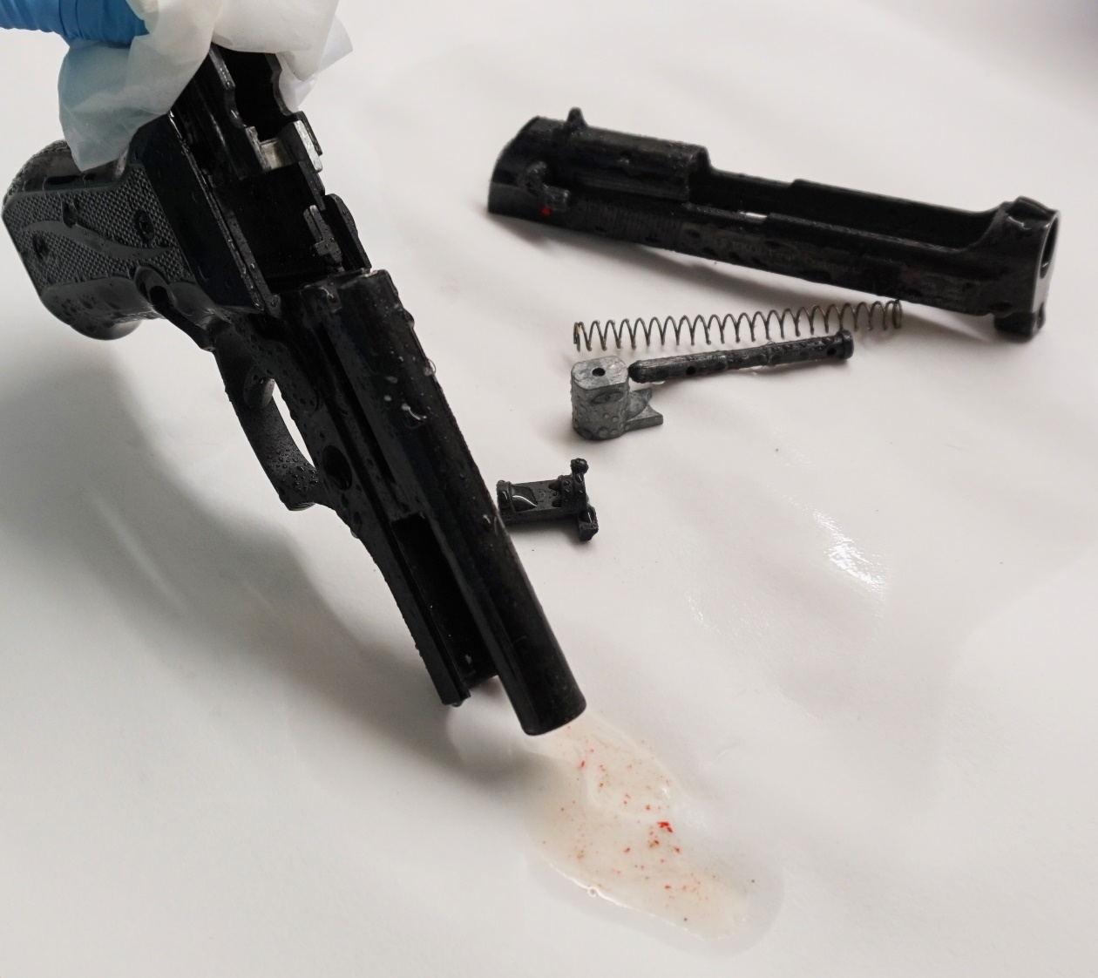
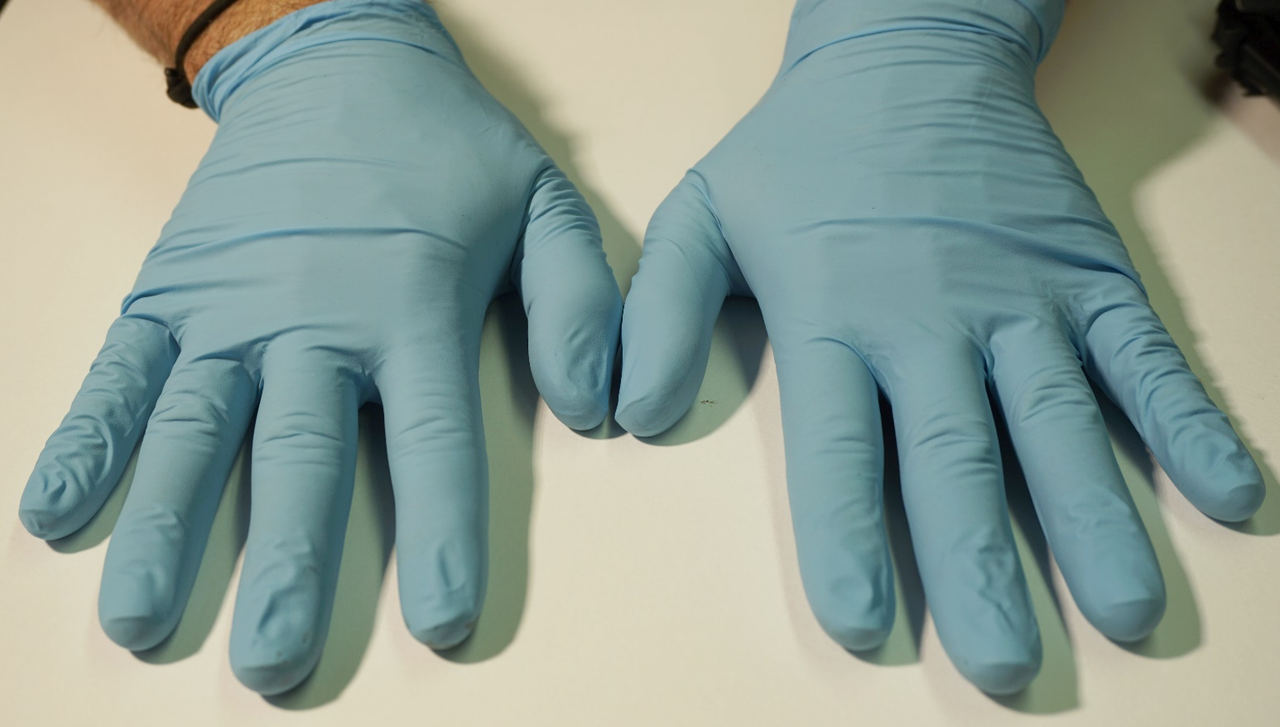
Supplementary Figure 3
A
B
C
D
Notes:
Supp. Fig. 3
Weapon: Ekol Firat pistol
Ammunition: Skullfire 9 mm
Model Setup: Single layer chamois leather + vacuum bag
A: View outer surfaces, B: View muzzle/barrel, C: Hands of shooter, D: Flowthrough with biological traces at rinsing the barrel

Slide 4
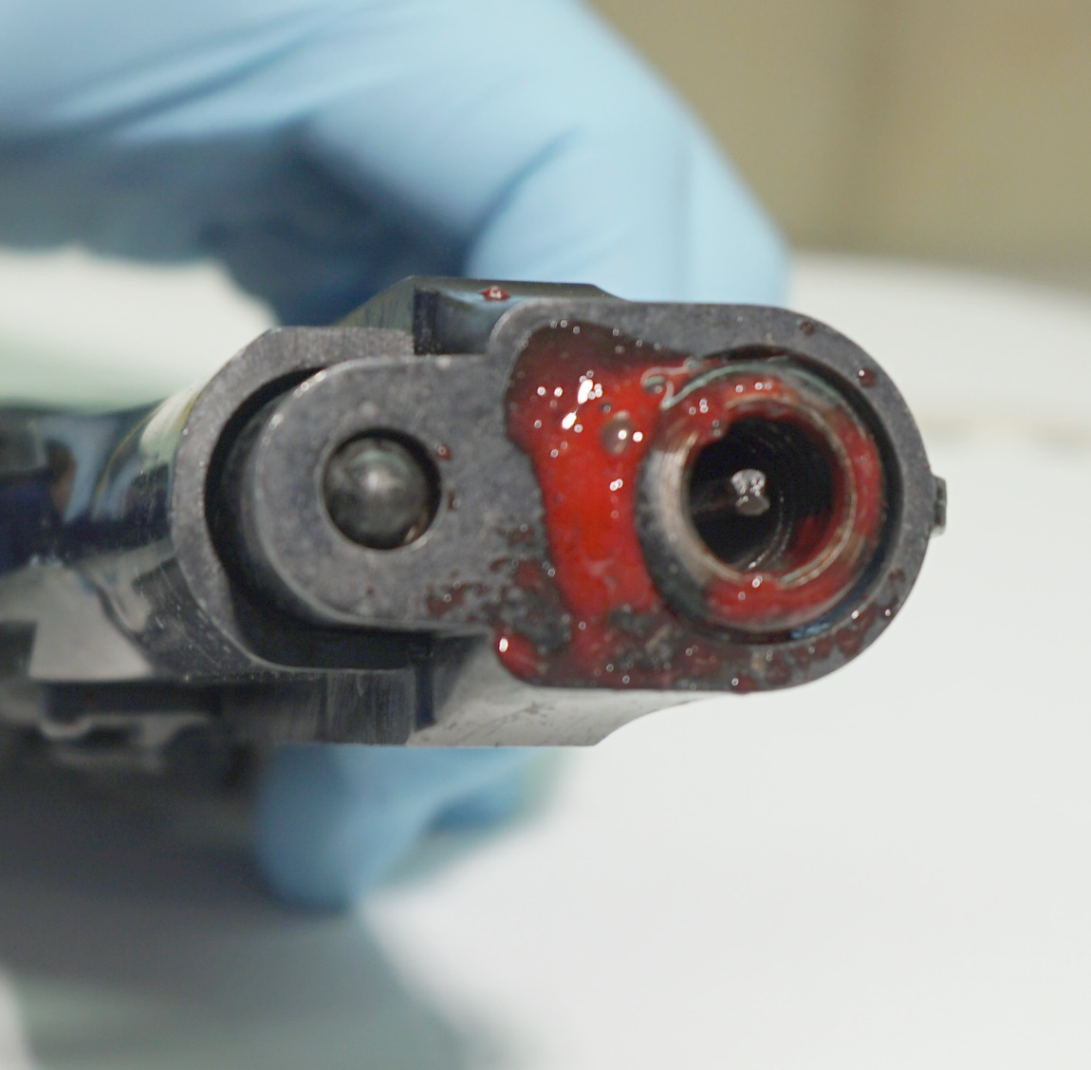
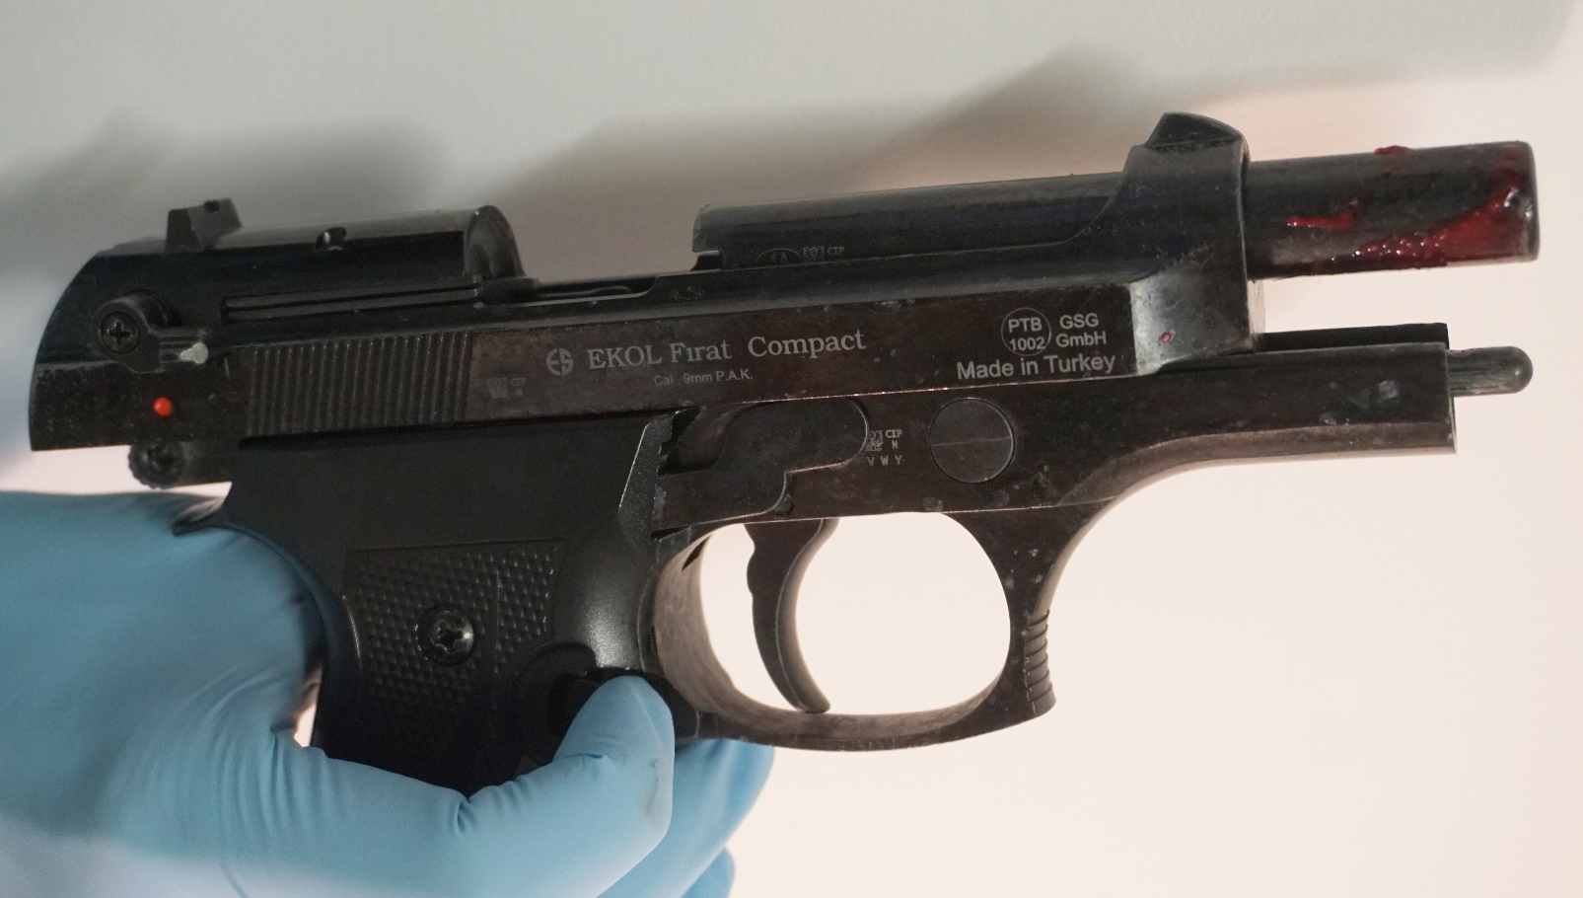
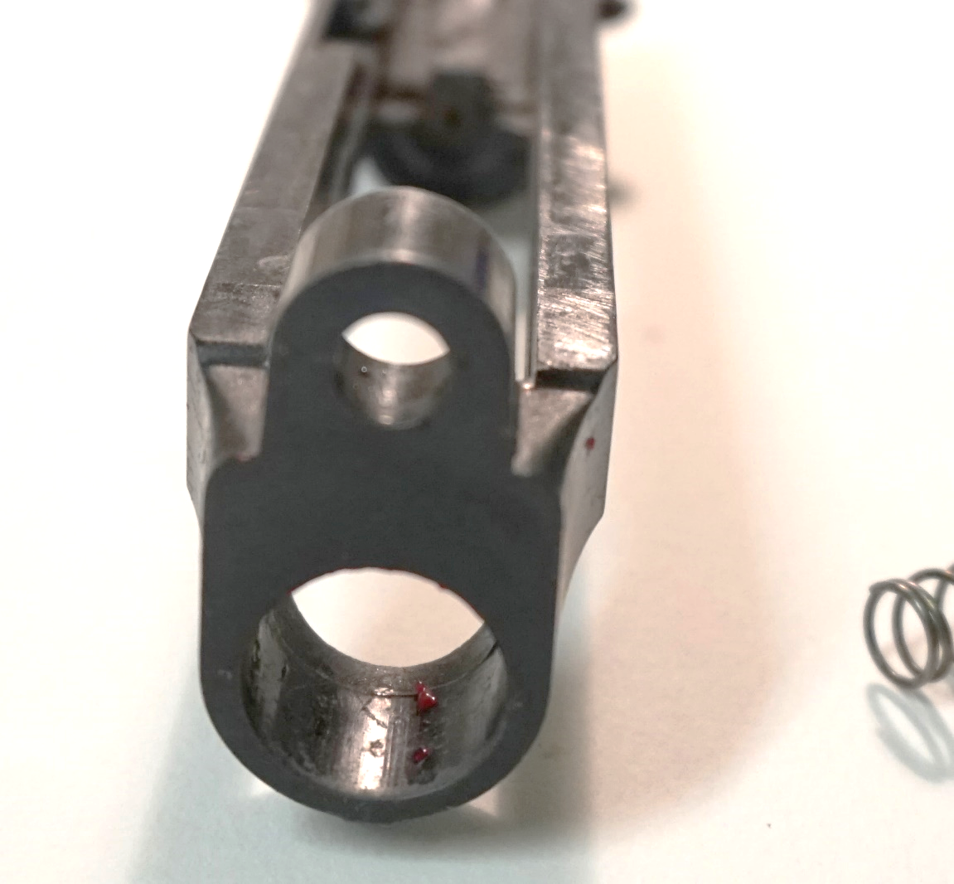
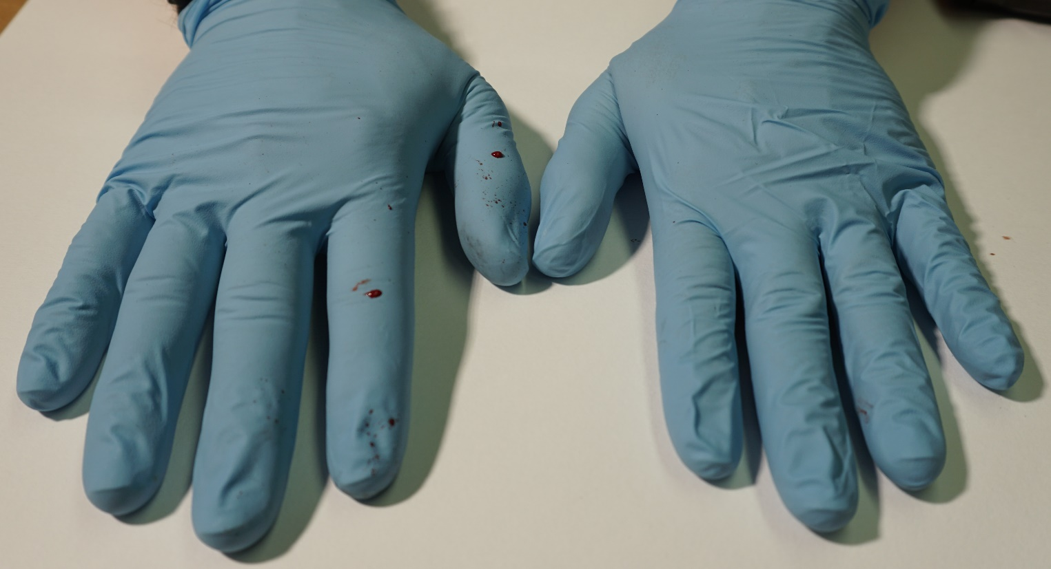
Supplementary Figure 4
A
B
C
D
Notes:
Supp. Fig. 4
Weapon: Ekol Firat pistol
Ammunition: Özkursan 9 mm
Model Setup: Double layer chamois leather
A: View outer surfaces, B: View muzzle/barrel, C: Hands of shooter, D: Detachable slide with traces on inner surface

Slide 5
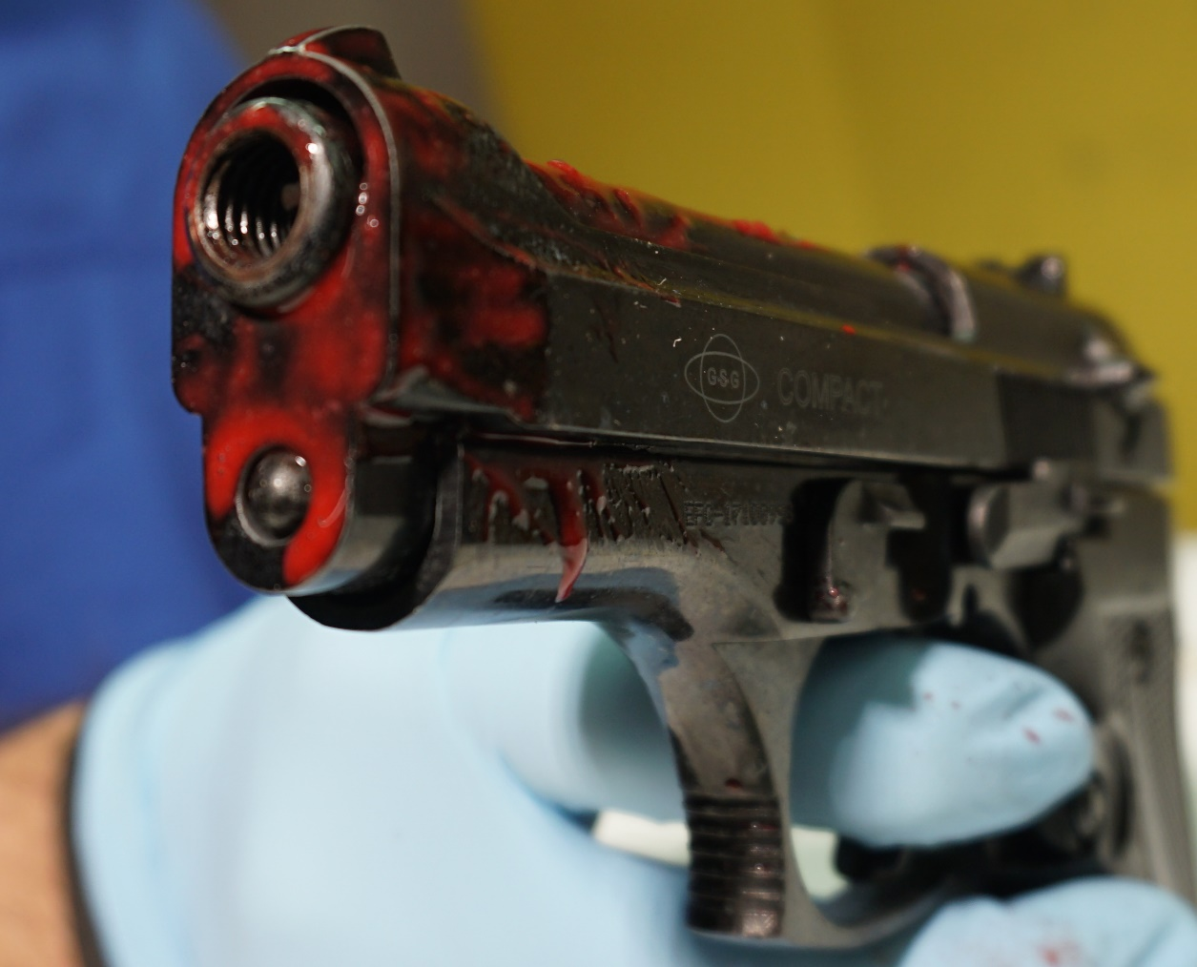
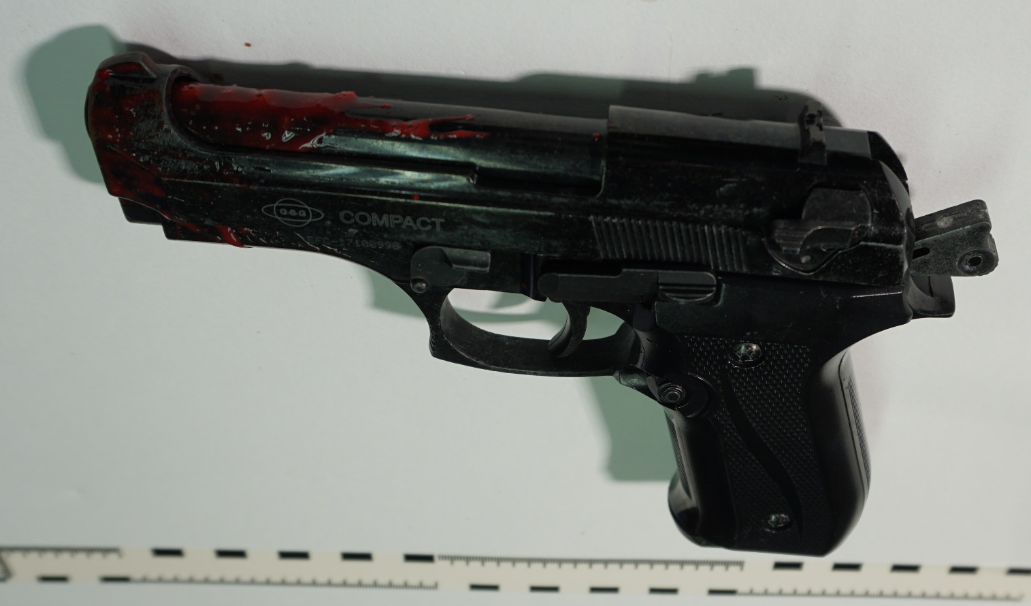
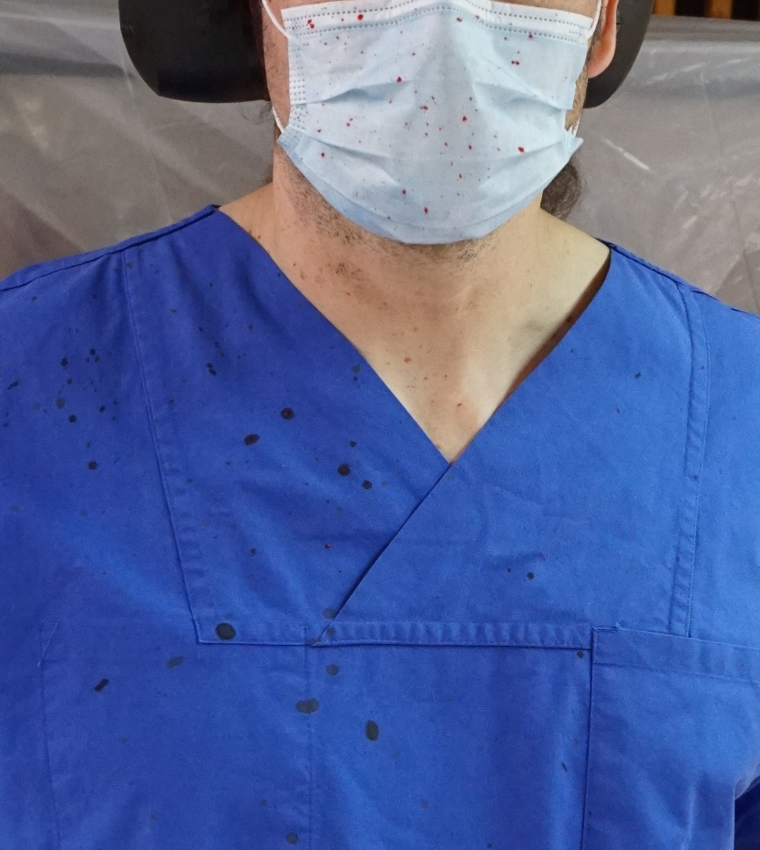
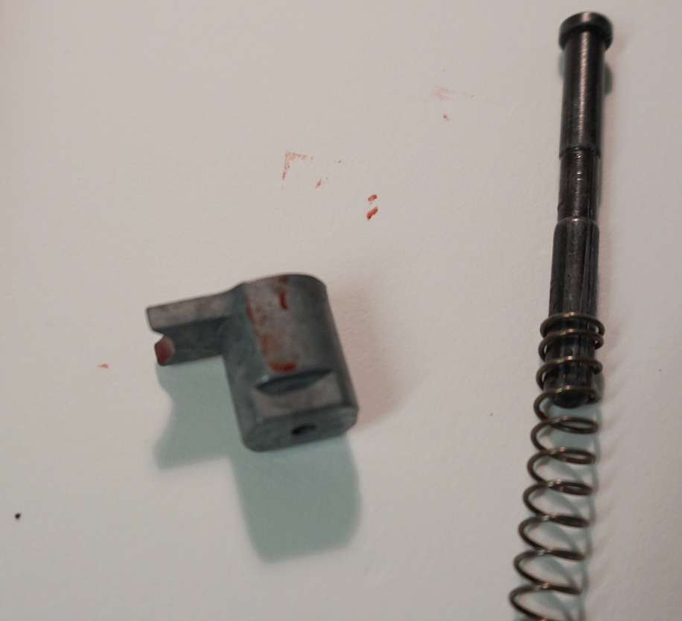
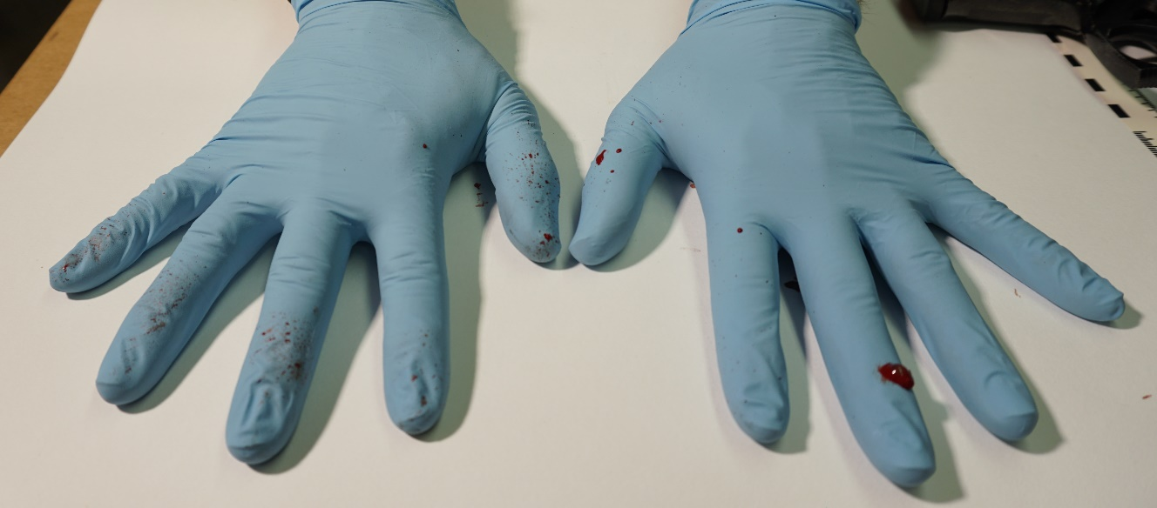
Supplementary Figure 5
A
B
D
C
E
Notes:
Supp. Fig. 5
Weapon: Ekol Firat pistol
Ammunition: Özkursan 9 mm
Model Setup: Single layer chamois leather + vacuum bag
A: View outer surfaces, B: View muzzle/barrel, C: Hands of shooter, D: Backspatter traces on shooter’s clothes and mask, E: Traces on small detachable parts of pistol

Slide 6
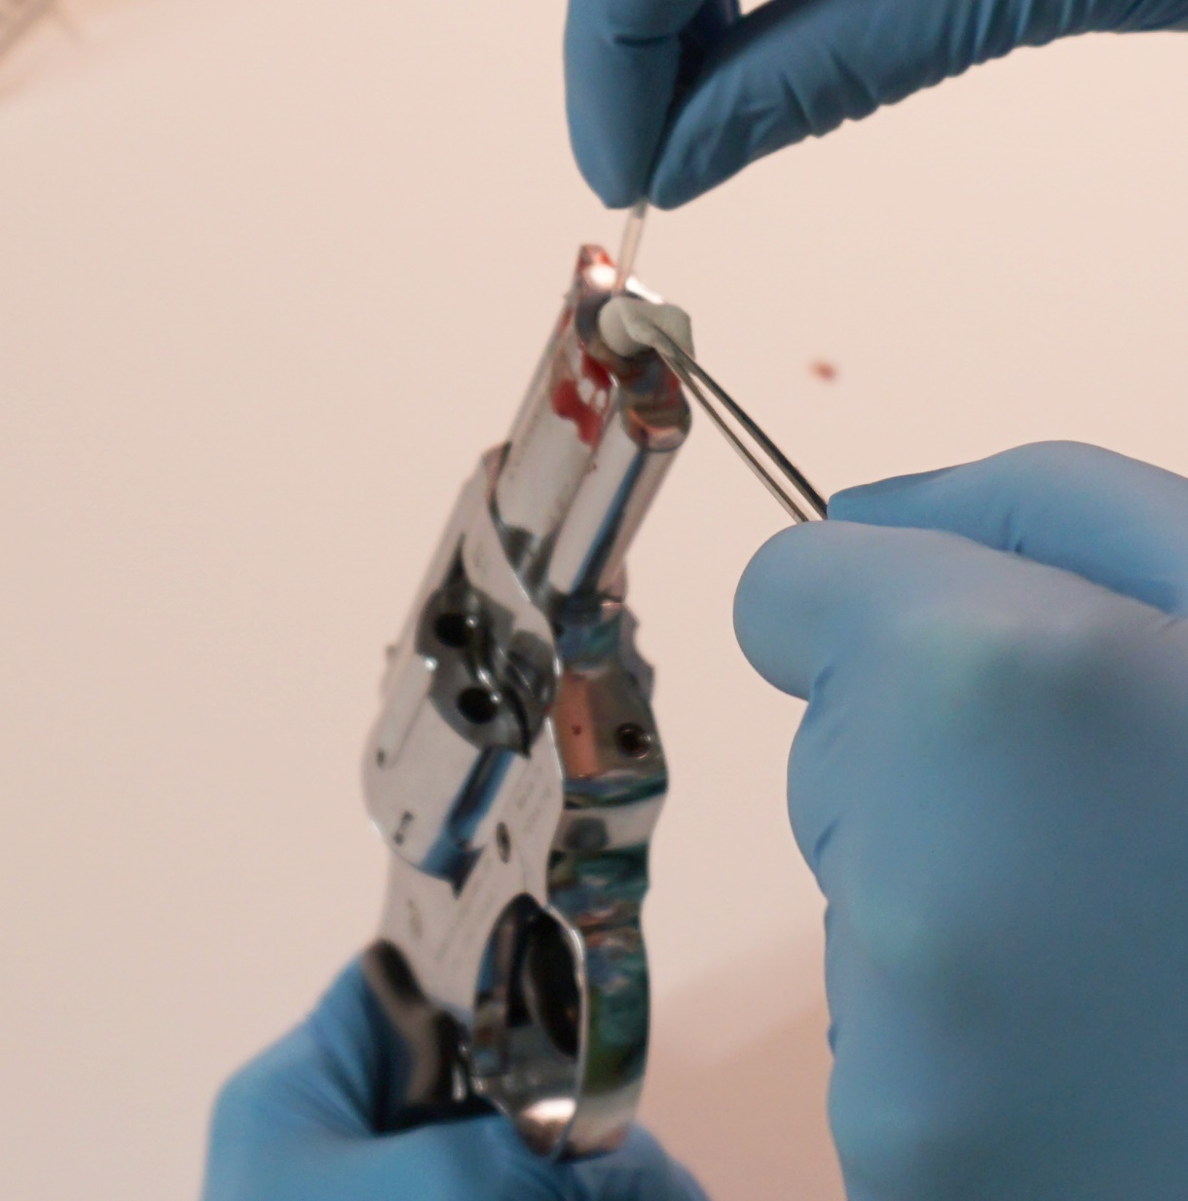
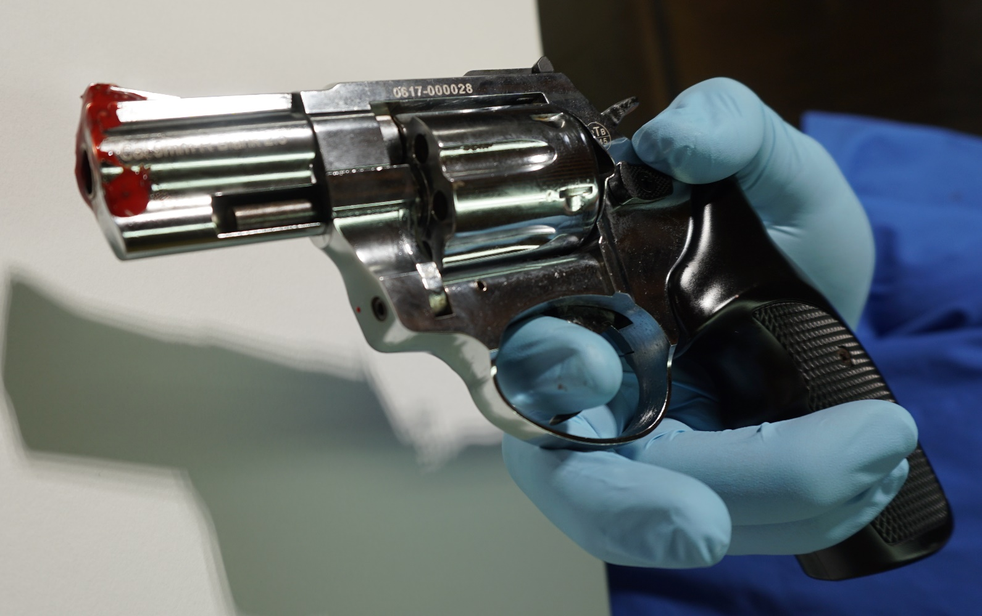
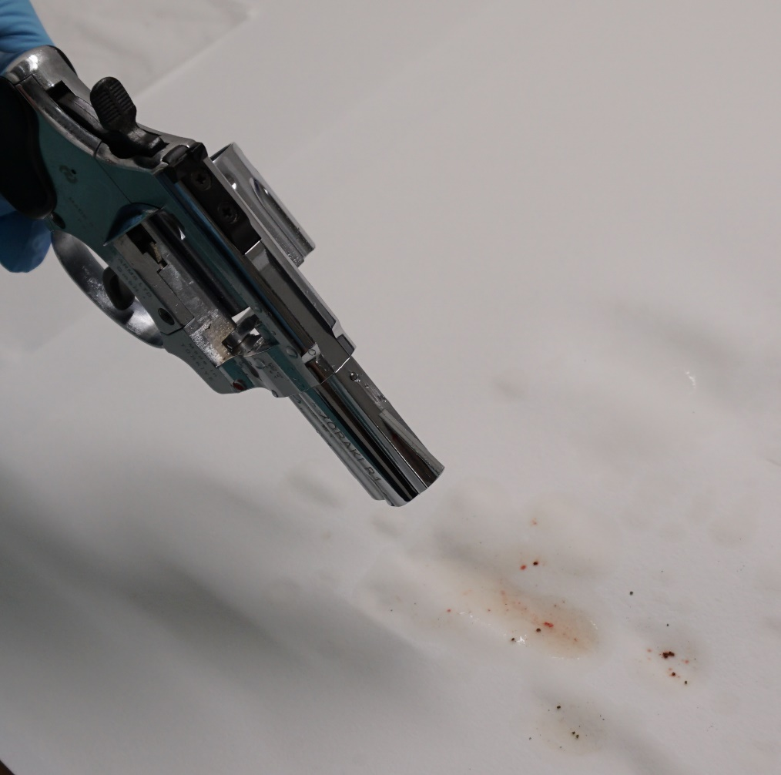
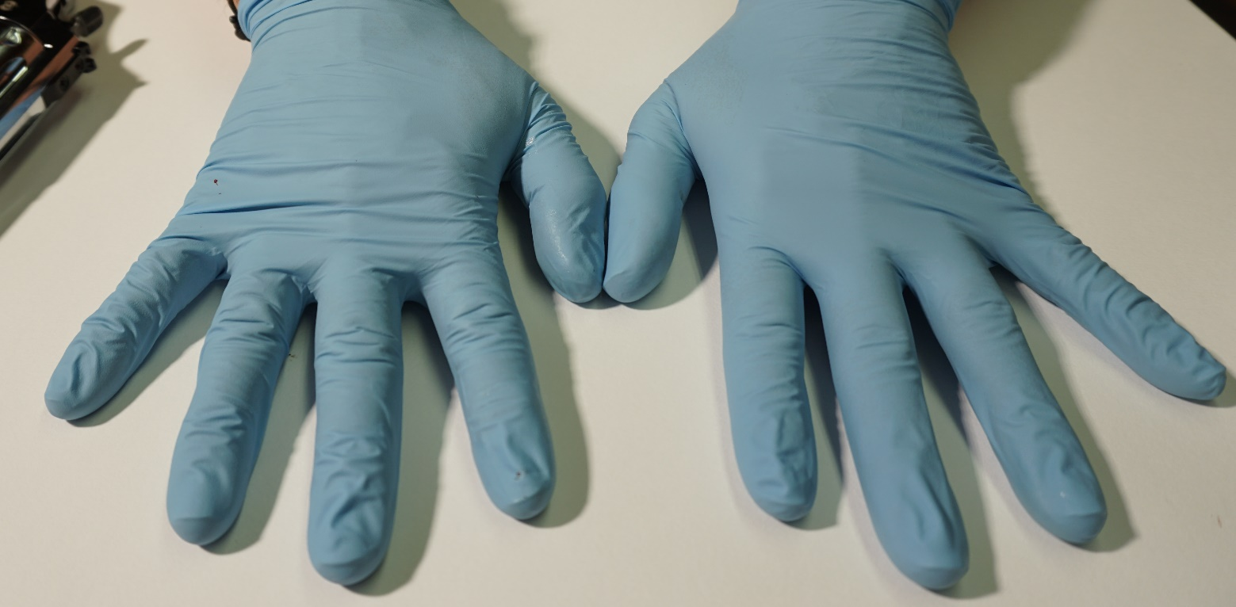
Supplementary Figure 6
A
B
C
D
Notes:
Supp. Fig. 6
Weapon: Zoraki R1 Revolver
Ammunition: Walther 9 mm
Model Setup: Single layer chamois leather
A: View outer surfaces, B: View muzzle/barrel, C: Hands of shooter, D: Flowthrough with biological traces at rinsing the barrel

Slide 7
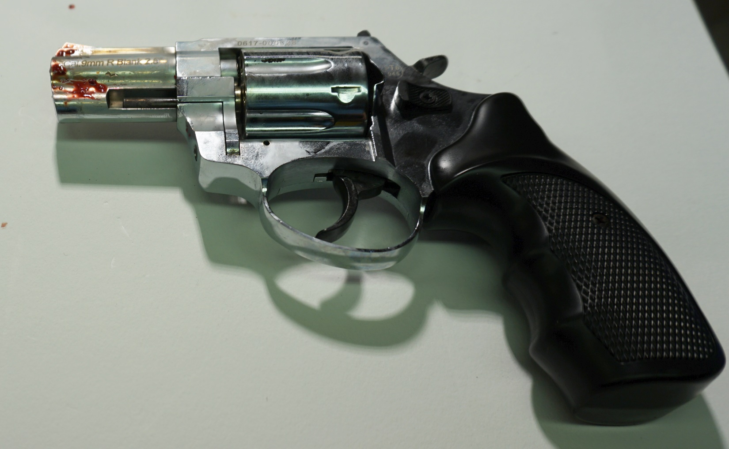
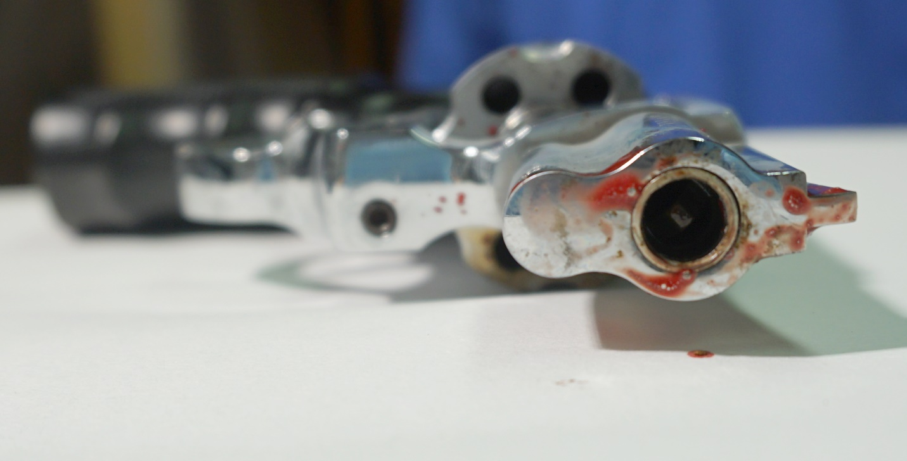
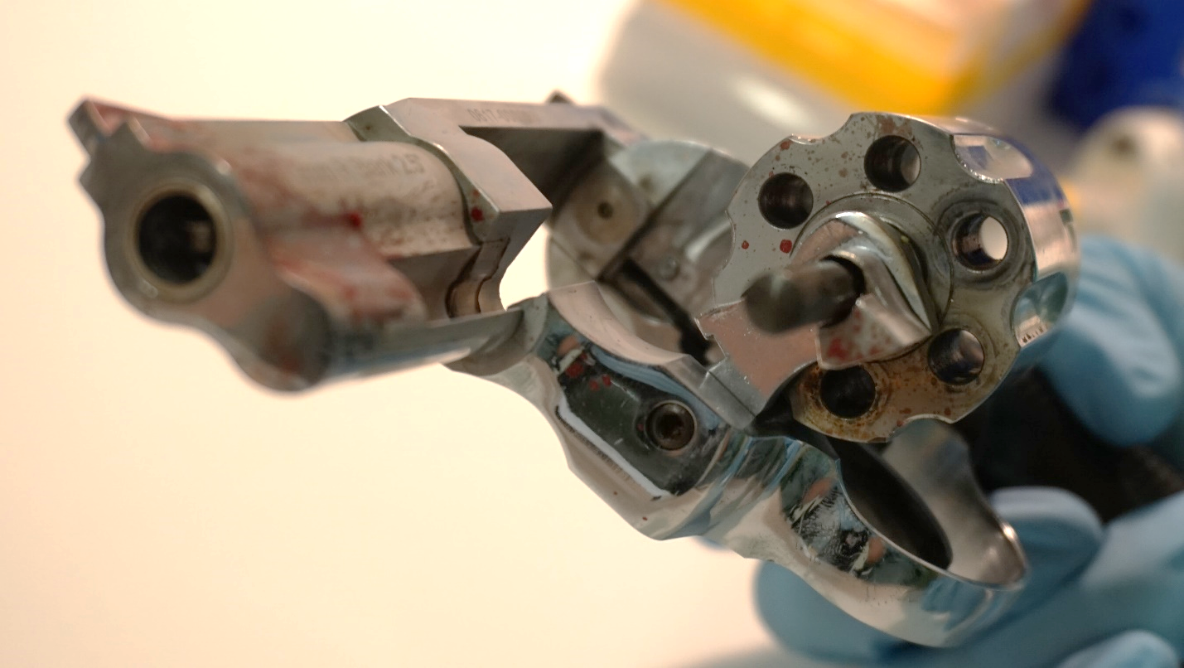
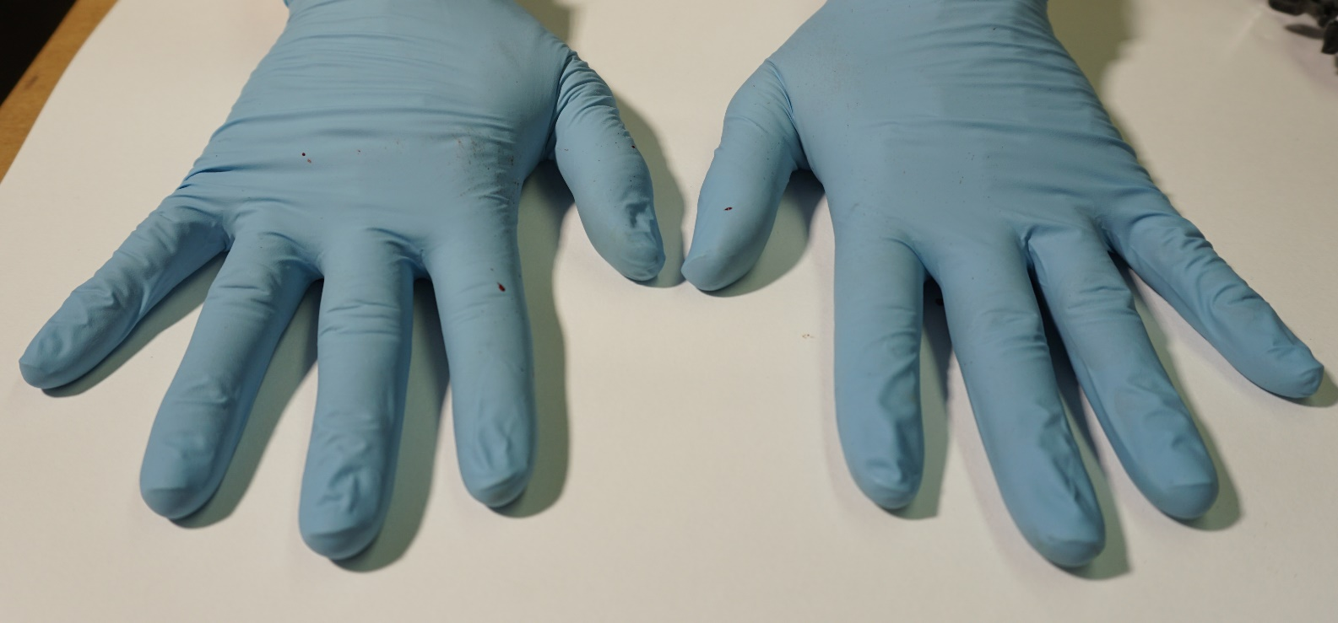
Supplementary Figure 7
B
A
C
D
Notes:
Supp. Fig. 7
Weapon: Zoraki R1 Revolver
Ammunition: Geco 9 mm
Model Setup: Double layer chamois leather
A: View outer surfaces, B: View muzzle/barrel, C: Hands of shooter, D: Backspatter traces visible on cylinder and trigger guard

Slide 8
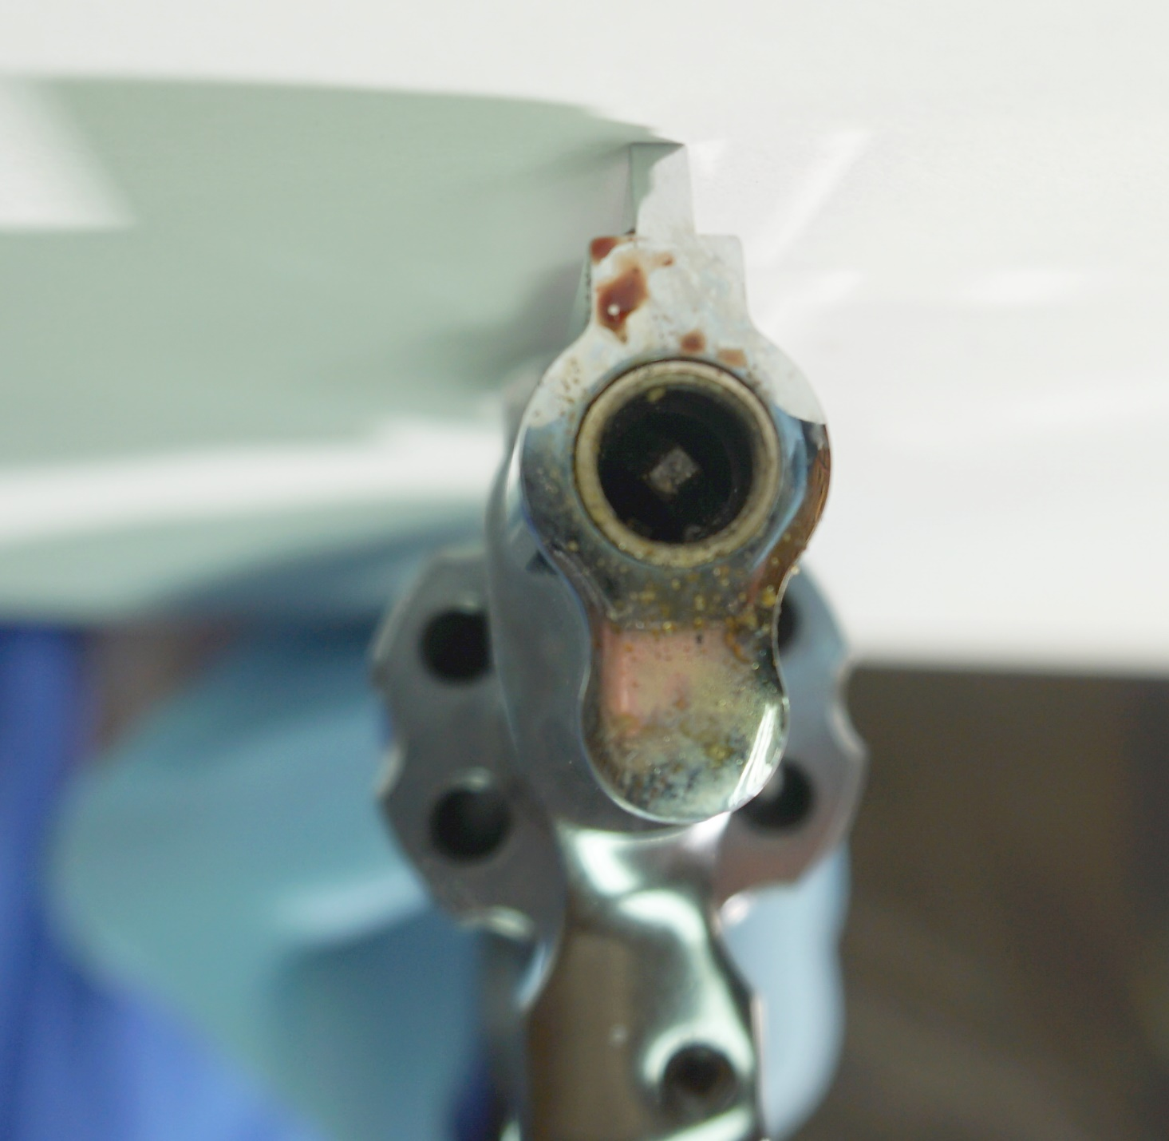
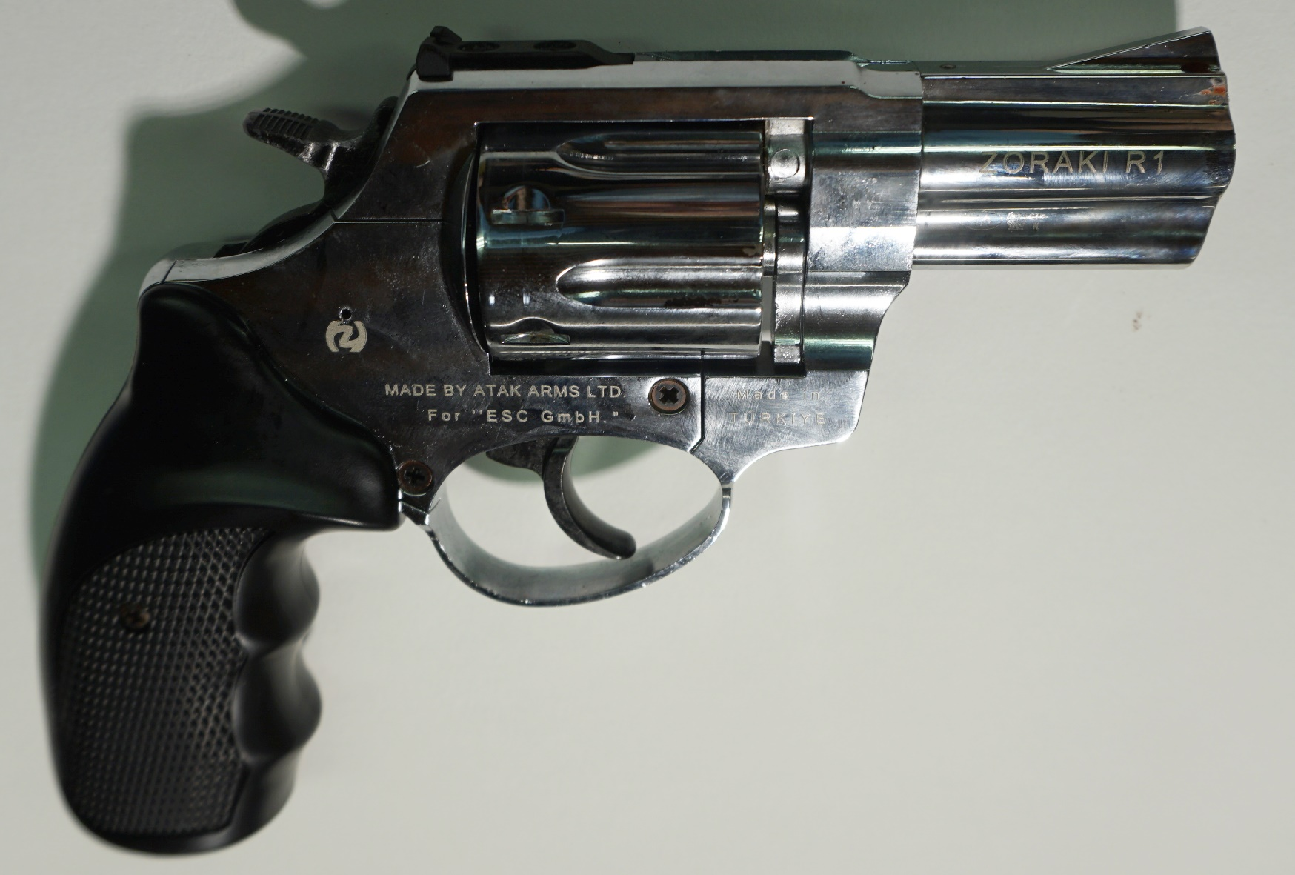
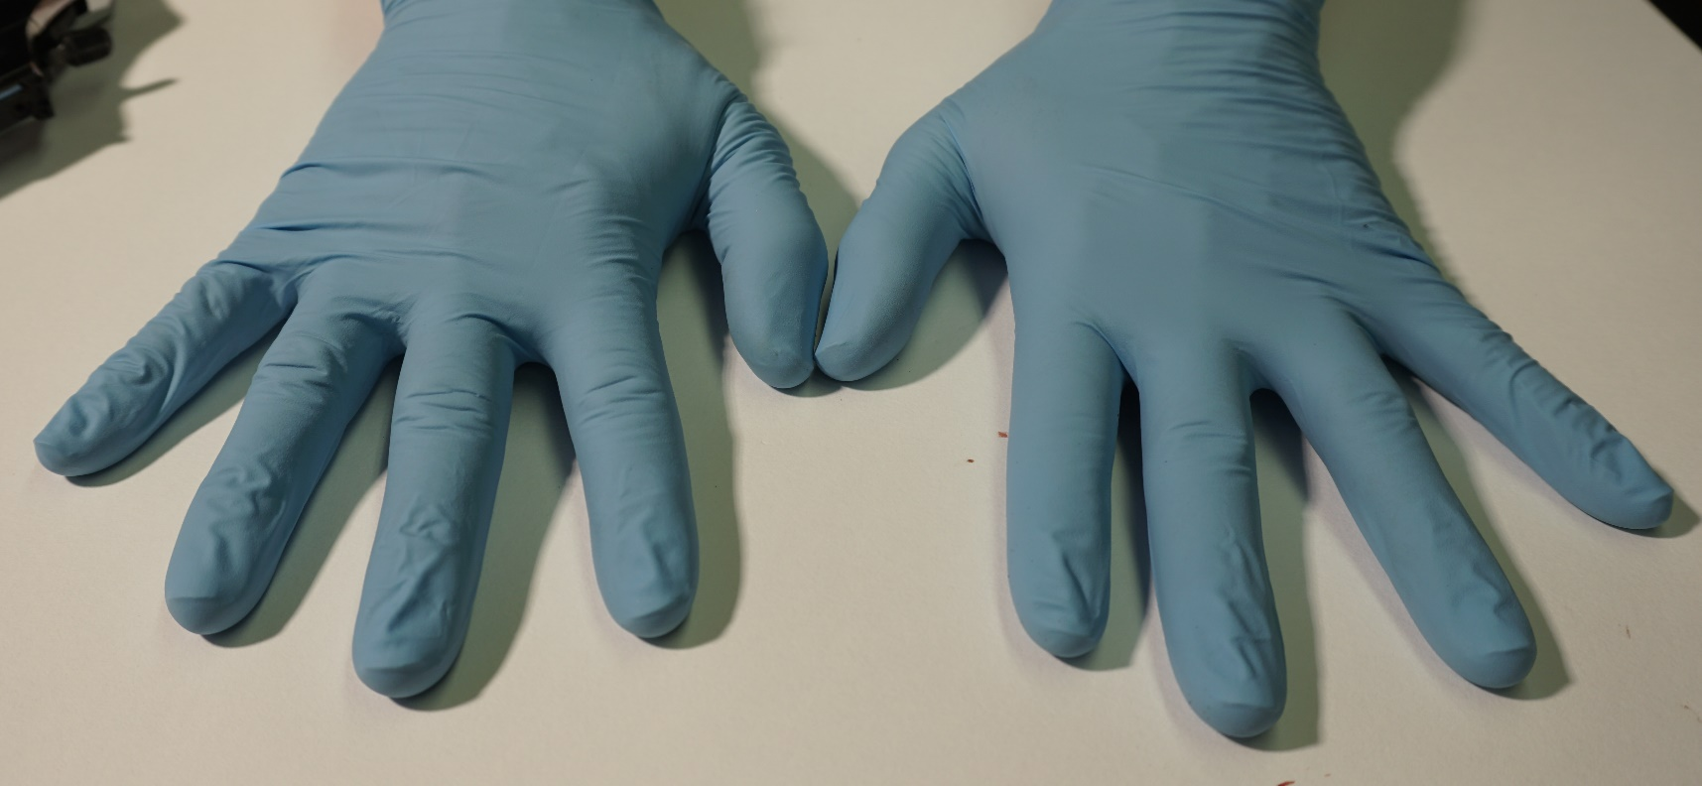
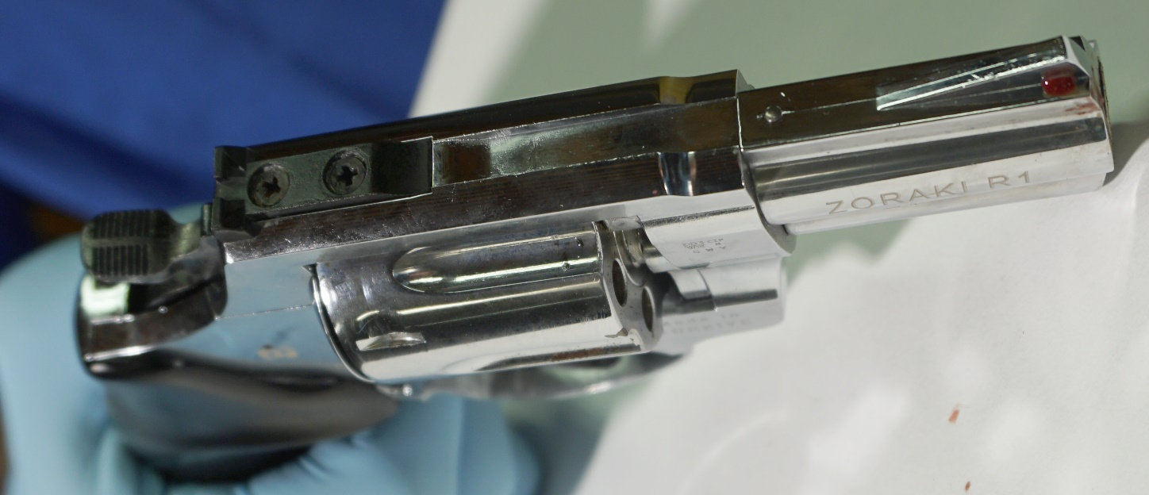
Supplementary Figure 8
A
B
D
C
Notes:
Supp. Fig. 8
Weapon: Zoraki R1 Revolver
Ammunition: Walther 9 mm
Model Setup: Single layer chamois leather + vacuum bag
A: View outer surfaces, B: View muzzle/barrel, C: Hands of shooter, D: View from top

Slide 9
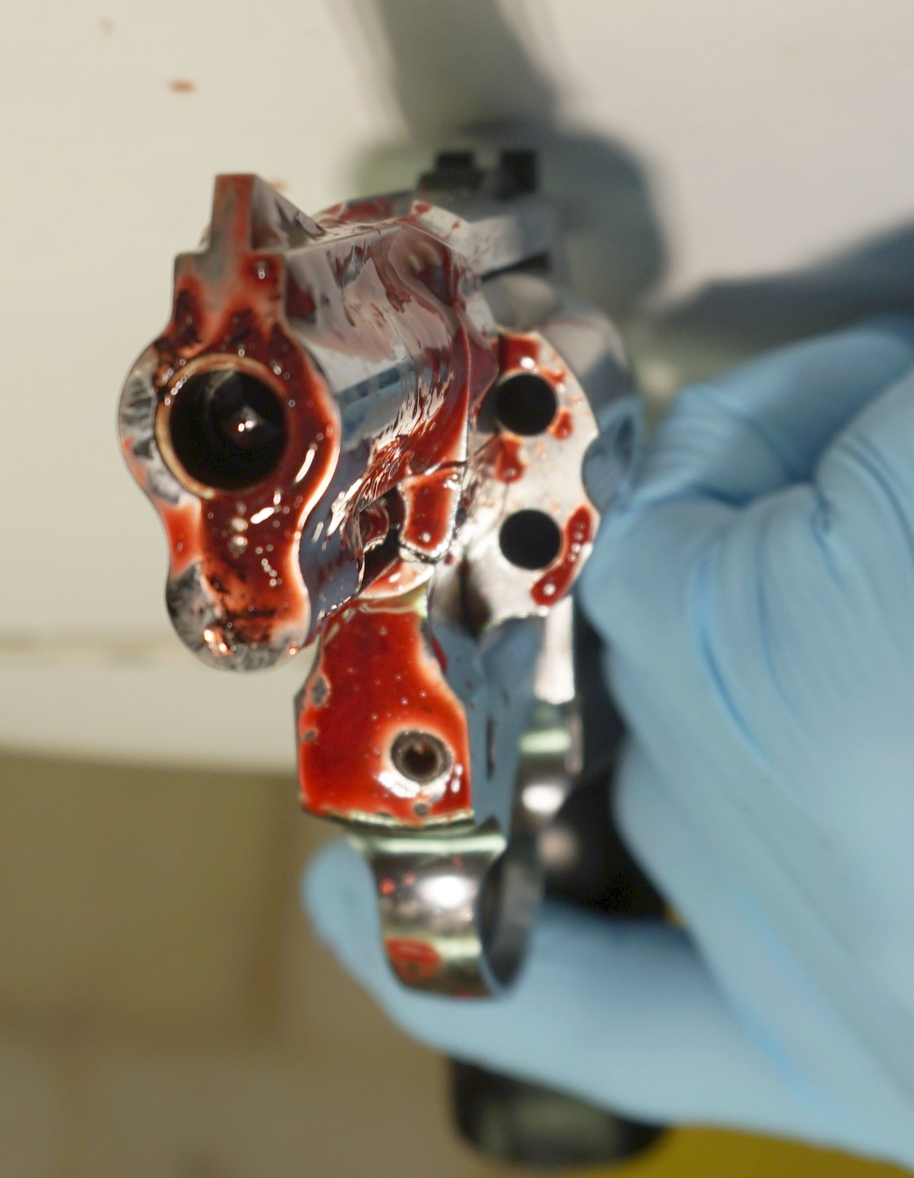
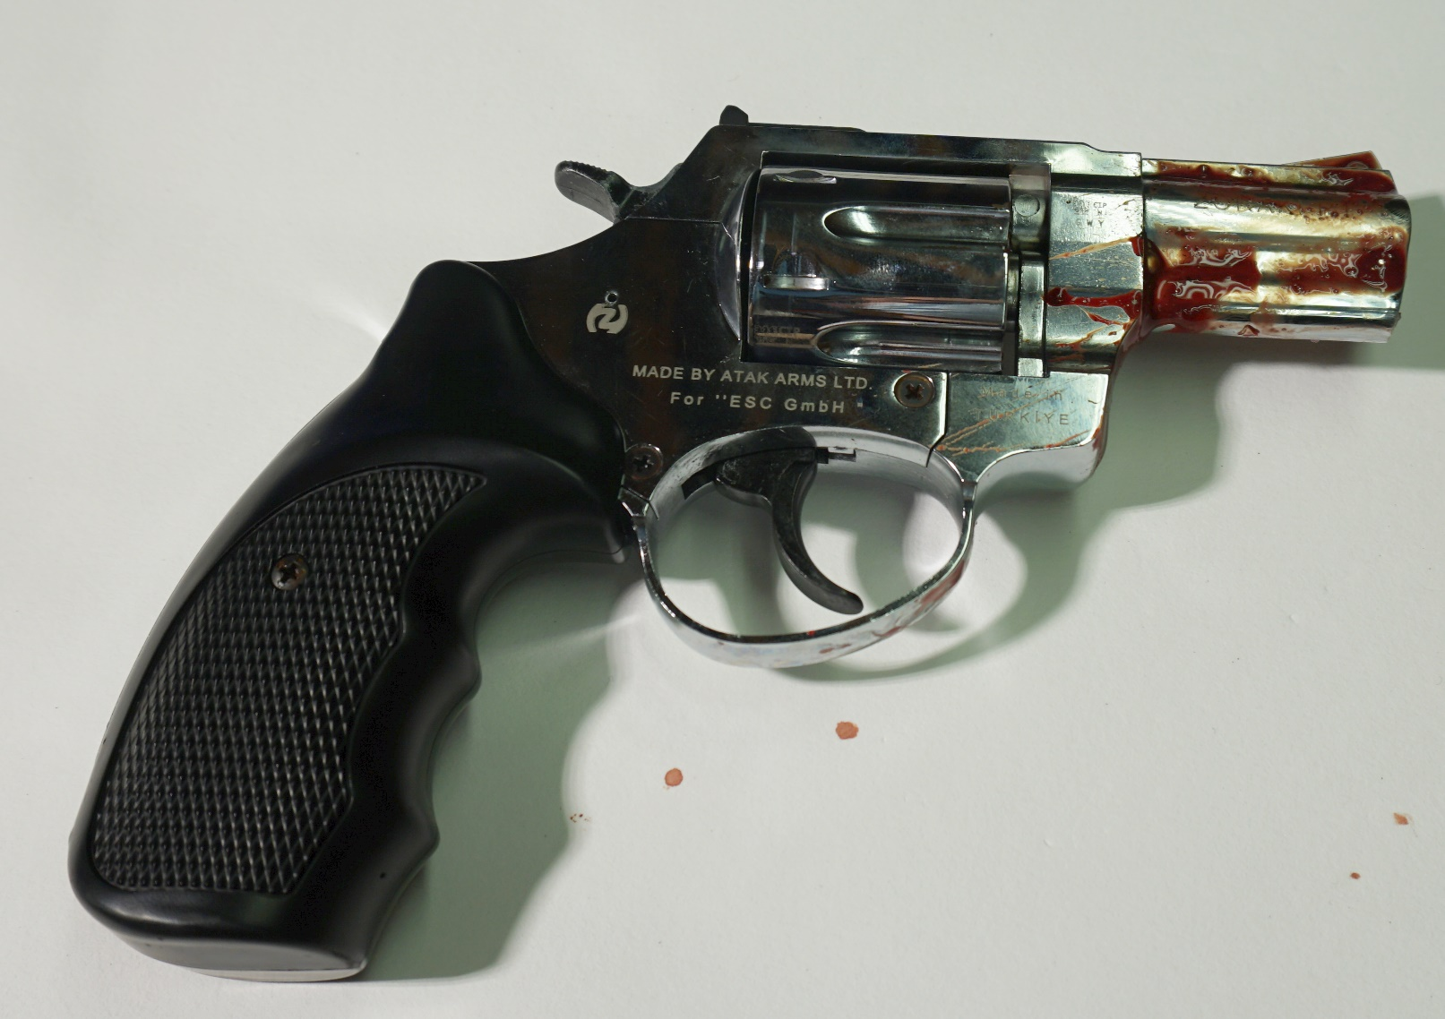
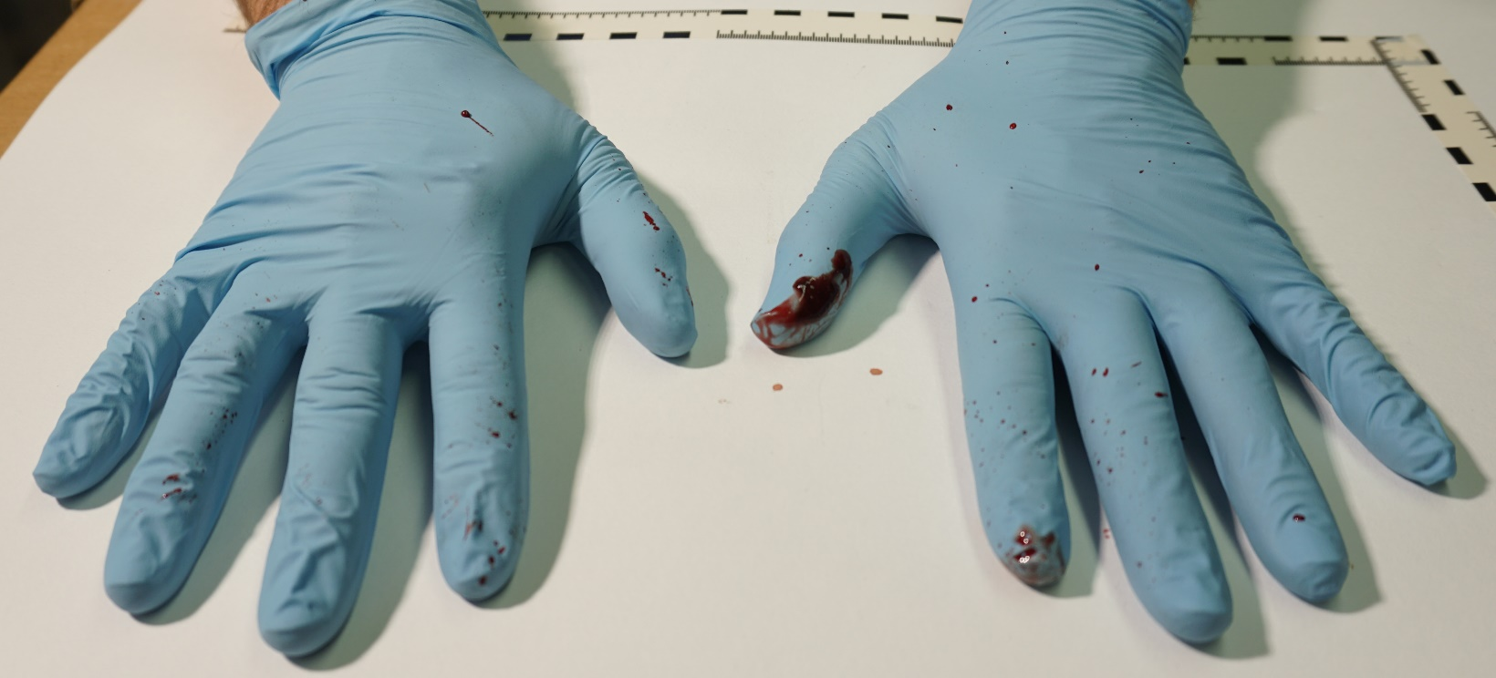
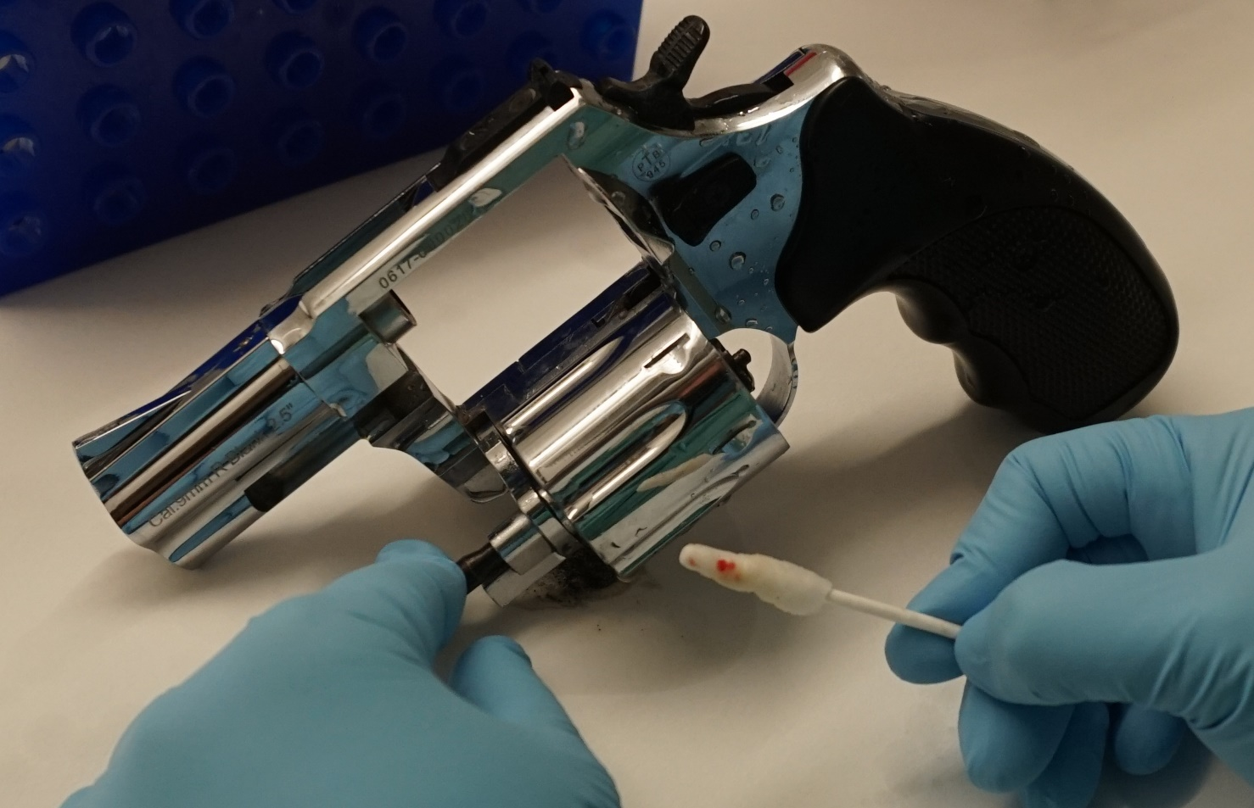
Supplementary Figure 9
A
B
C
D
Notes:
Supp. Fig. 9
Weapon: Zoraki R1 Revolver
Ammunition: Nobel 9 mm Black Powder
Model Setup: Single layer chamois leather
A: View outer surfaces, B: View muzzle/barrel, C: Hands of shooter, D: Traces collected from cartridge chamber in cylinder

Slide 10
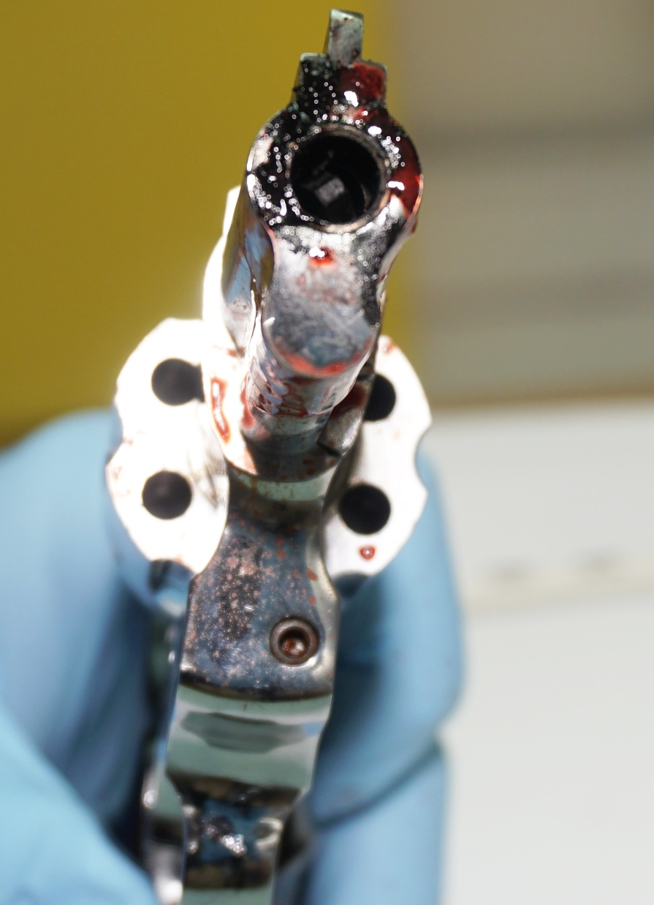
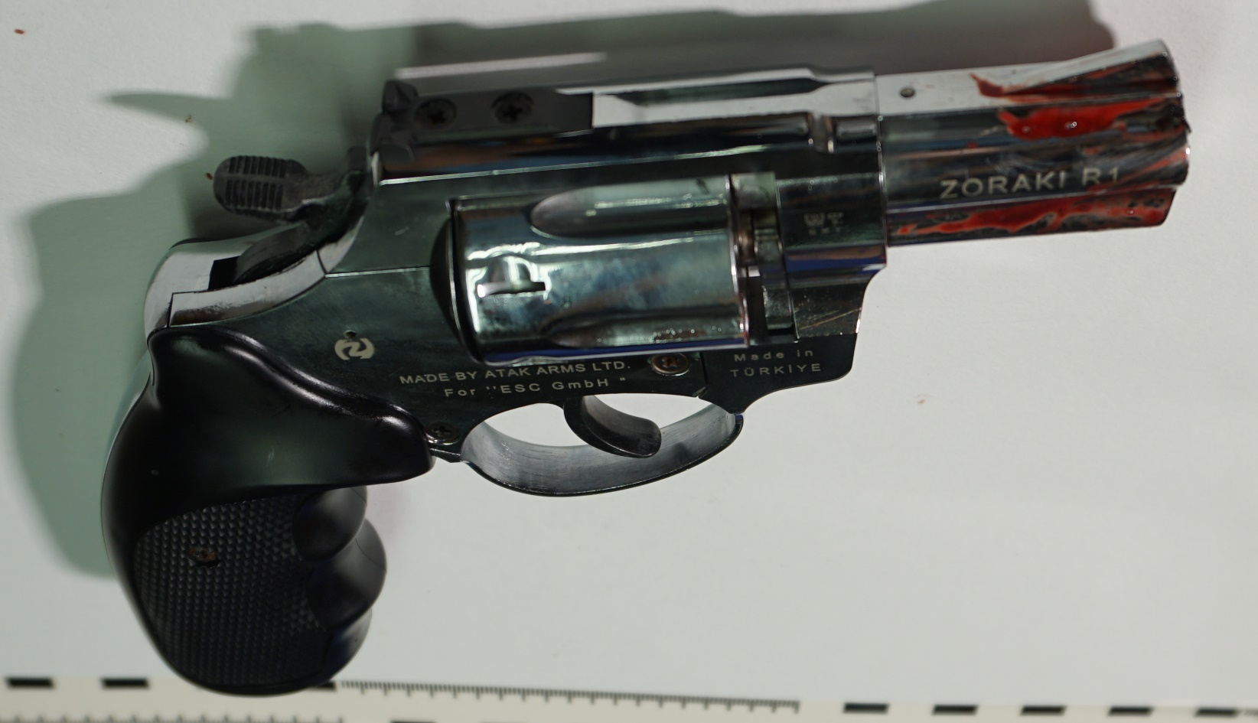
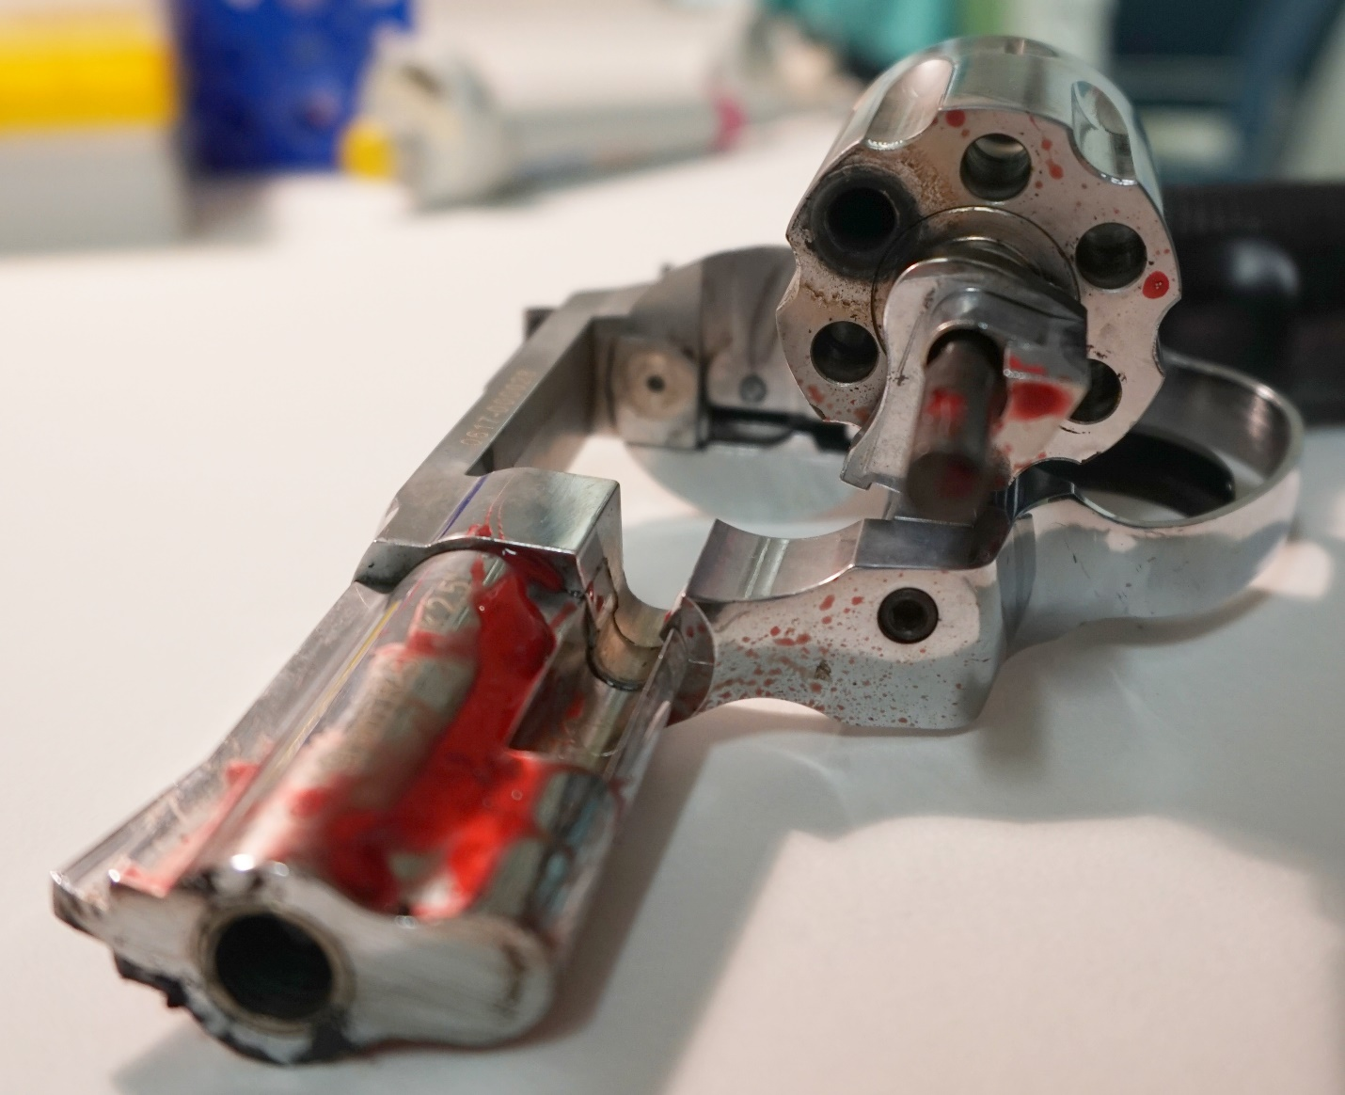
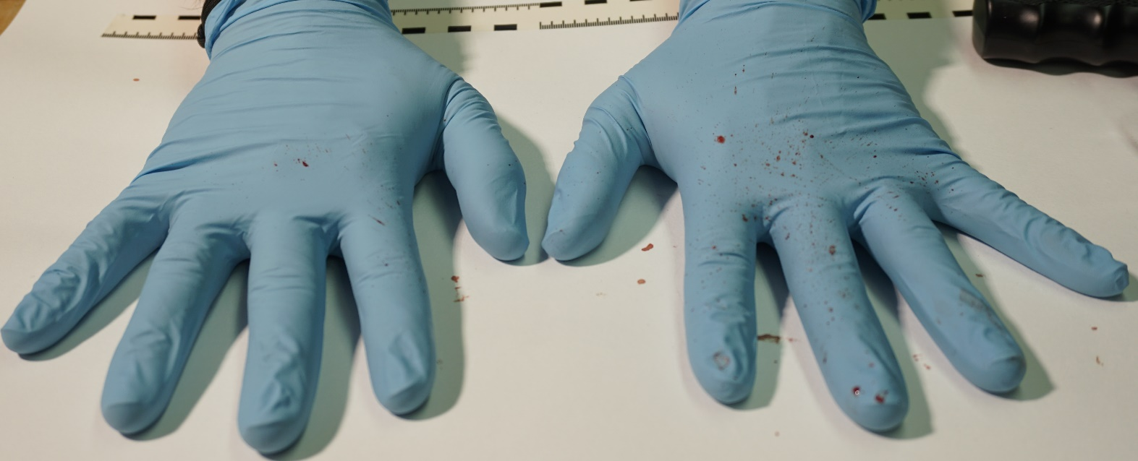
Supplementary Figure 10
A
B
D
C
Notes:
Supp. Fig. 10
Weapon: Zoraki R1 Revolver
Ammunition: Nobel 9 mm Black Powder
Model Setup: Single layer chamois leather + vacuum bag
A: View outer surfaces, B: View muzzle/barrel, C: Hands of shooter, D: Backspatter traces visible on cylinder and trigger guard

Slide 11
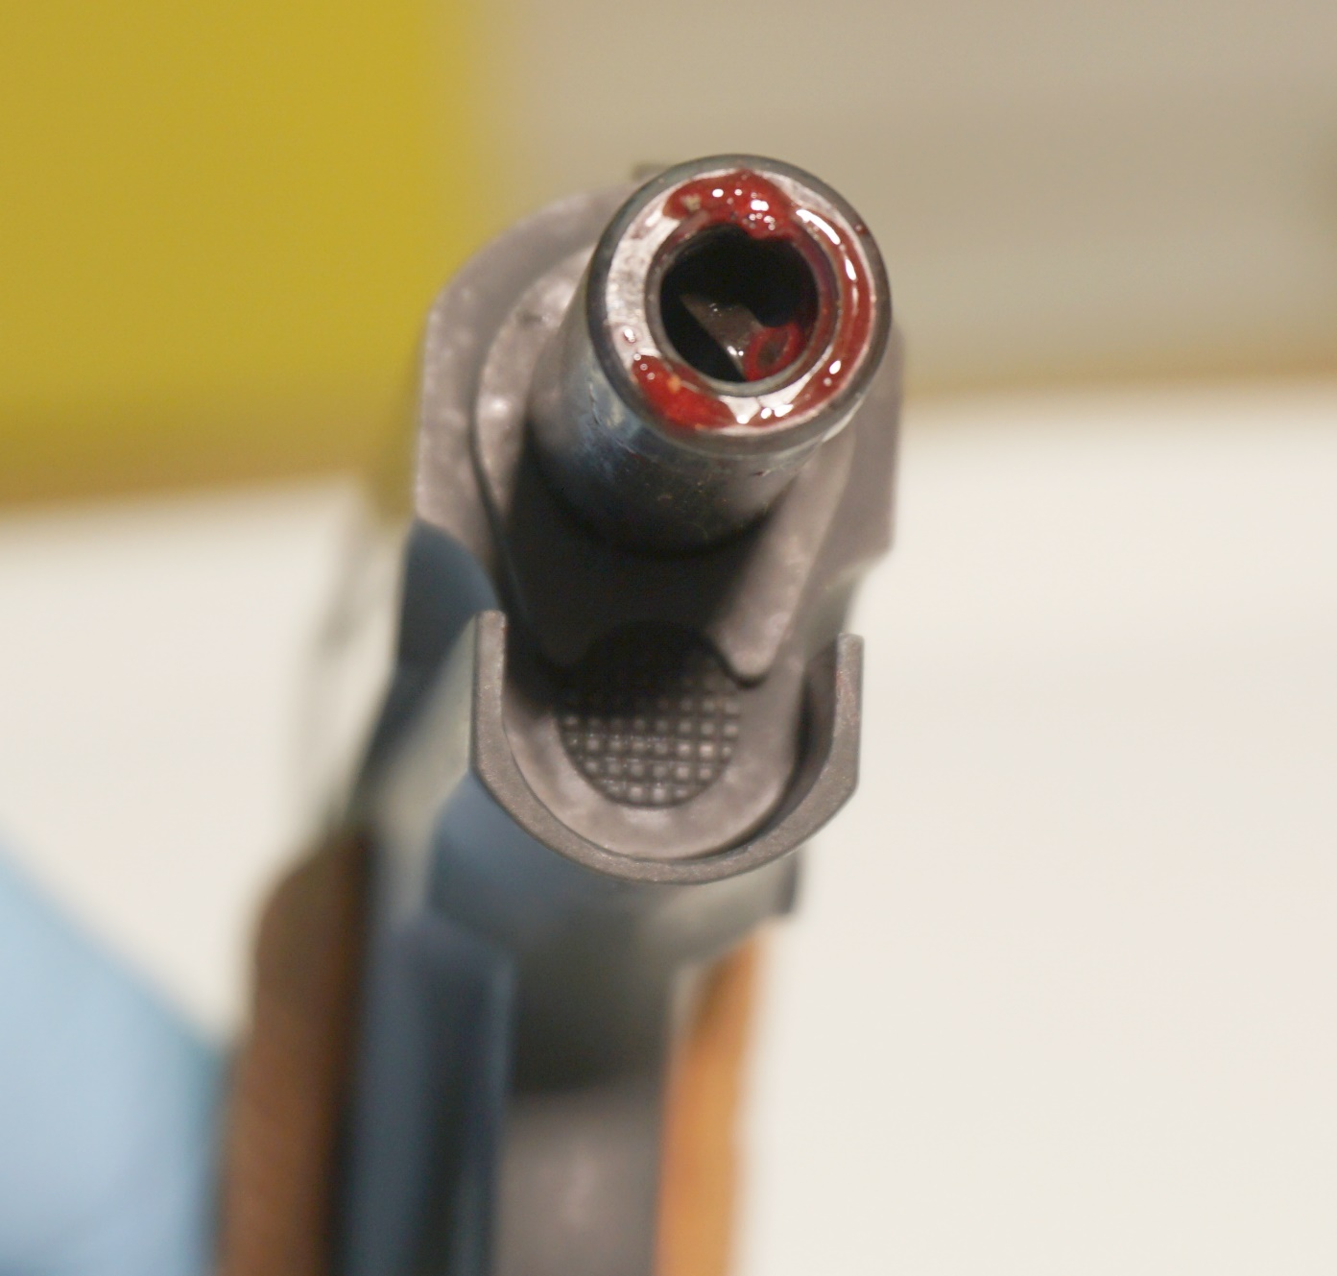
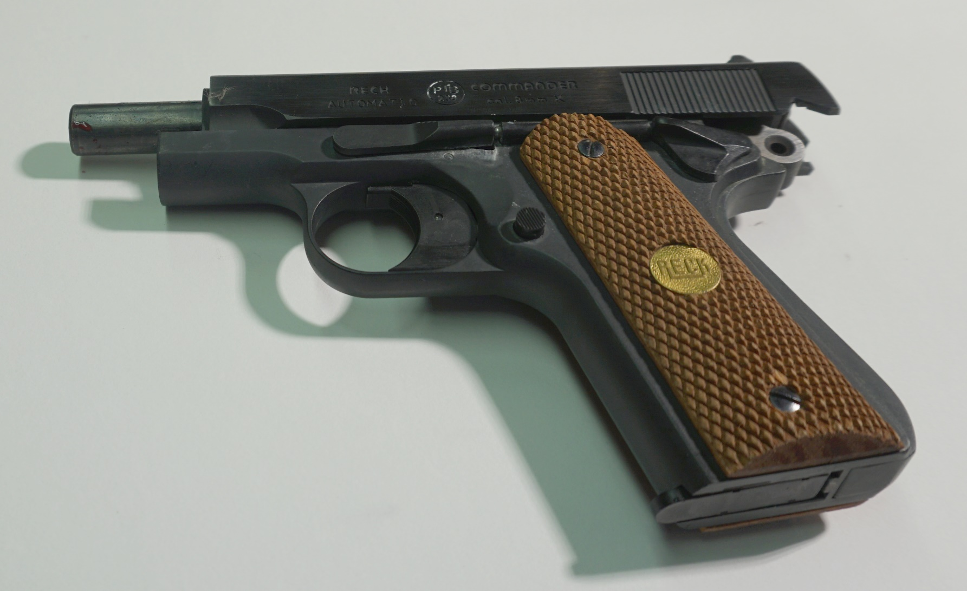
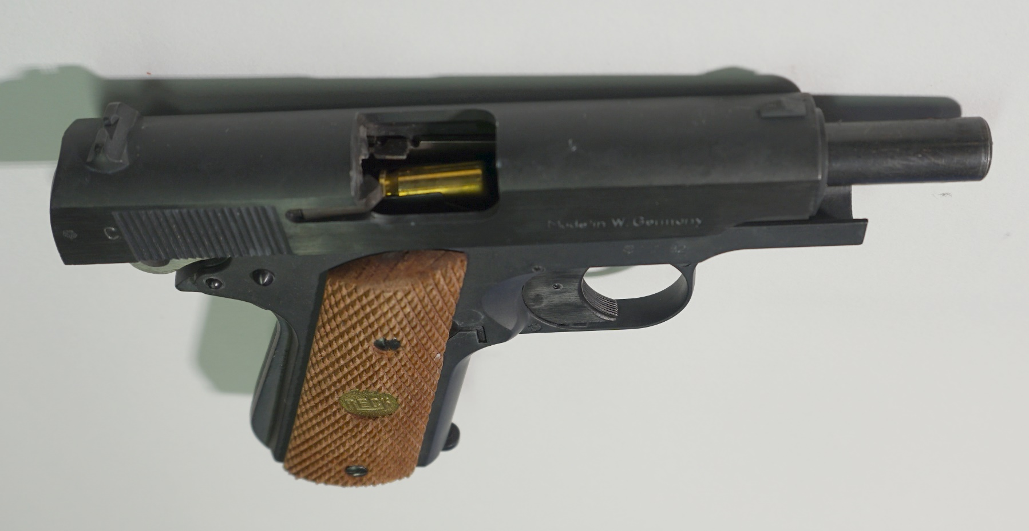
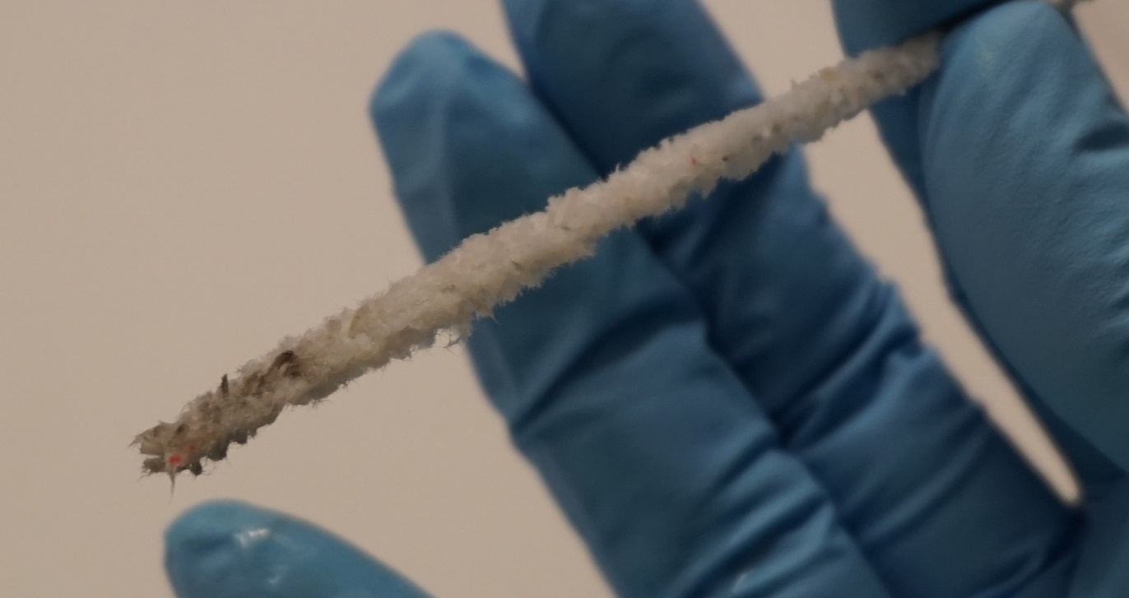
Supplementary Figure 11
A
B
C
D
Notes:
Supp. Fig. 11
Weapon: Reck Commander Pistol
Ammunition: Walther 8 mm
Model Setup: Single layer chamois leather
A: View outer surfaces, B: View muzzle/barrel, C: Hands of shooter, D: Minimal traces at pipe cleaner from inside the barrel

Slide 12
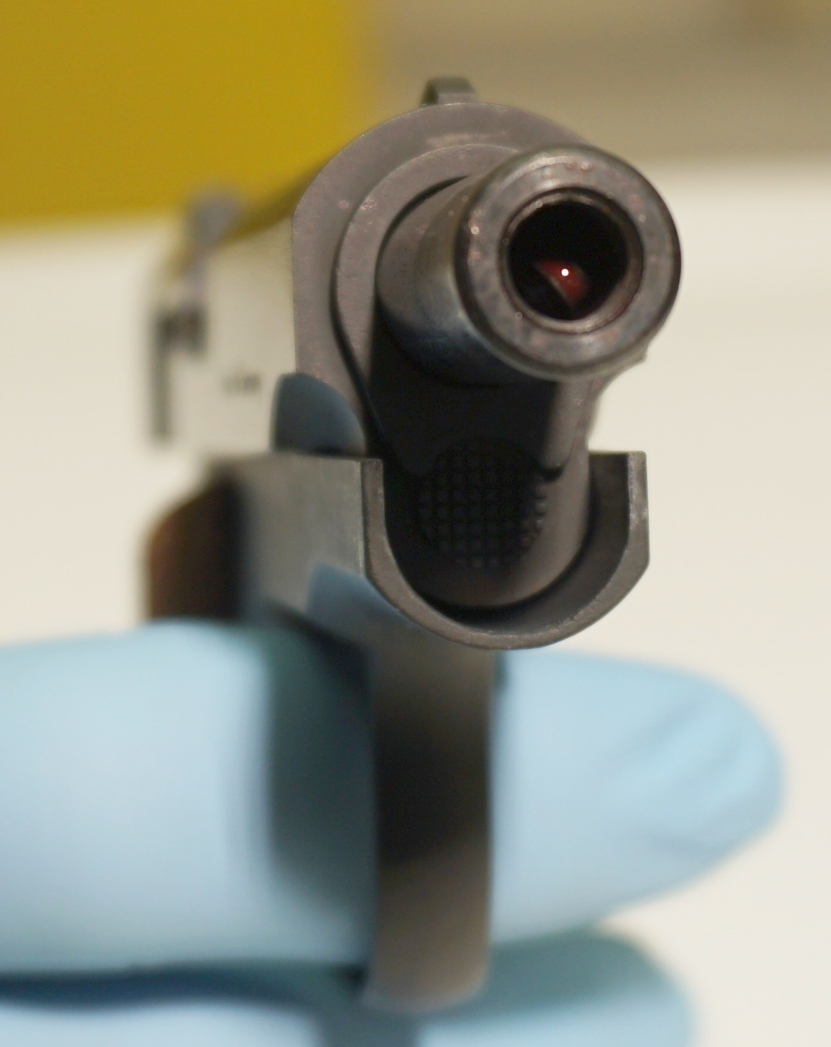
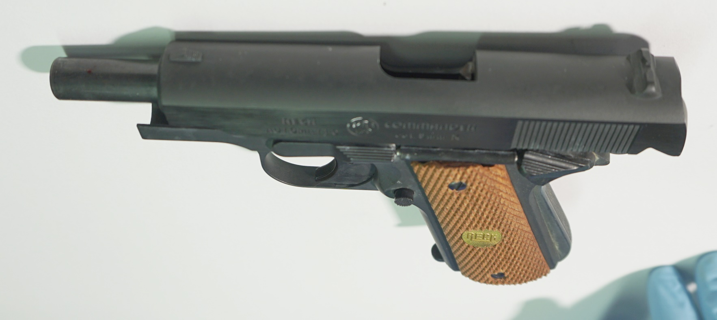
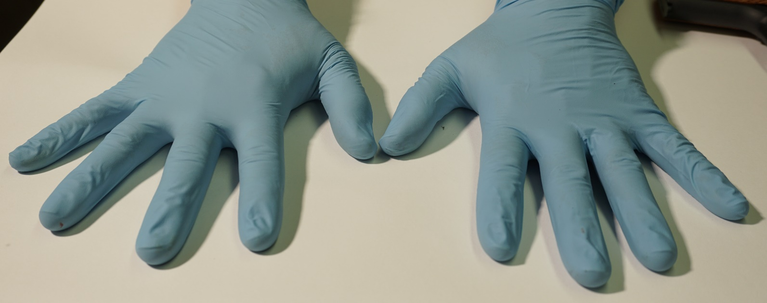
Supplementary Figure 12
A
B
C
Notes:
Supp. Fig. 12
Weapon: Reck Commander Pistol
Ammunition: Walther 8 mm
Model Setup: Double layer chamois leather
A: View outer surfaces, B: View muzzle/barrel, C: Hands of shooter

Slide 13
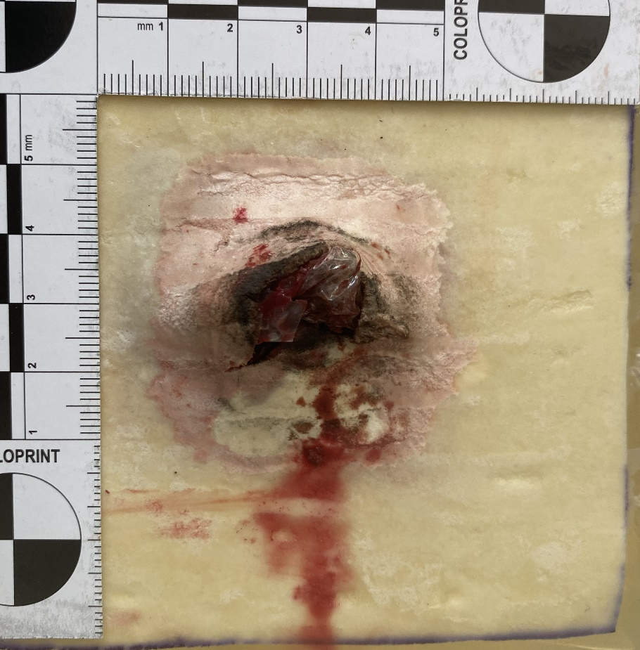
Supplementary Figure 13
A
B
C
D
E
F
Notes:
Supp. Fig. 13
Entrance Site at gelatin blocks after shots
A: Weapon: Ekol Firat pistol
Ammunition: Skullfire 9 mm
Model Setup: Single layer chamois leather
B: Weapon: Ekol Firat pistol
Ammunition: Skullfire 9 mm
Model Setup: Double layer chamois leather
C: Weapon: Ekol Firat pistol
Ammunition: Skullfire 9 mm
Model Setup: Single layer chamois leather + vacuum bag
D: Weapon: Ekol Firat pistol
Ammunition: Özkursan 9 mm
Model Setup: Double layer chamois leather
E: Weapon: Ekol Firat pistol
Ammunition: Özkursan 9 mm
Model Setup: Single layer chamois leather + vacuum bag
F: Weapon: Zoraki R1 Revolver
Ammunition: Walther 9 mm
Model Setup: Single layer chamois leather

Slide 14
Supplementary Figure 13
G
H
I
J
K
L
Notes:
Supp. Fig. 13 (cont.)
Entrance Site at gelatin blocks after shots
G: Weapon: Zoraki R1 Revolver
Ammunition: Geco 9 mm
Model Setup: Double layer chamois leather
H: Weapon: Zoraki R1 Revolver
Ammunition: Walther 9 mm
Model Setup: Single layer chamois leather + vacuum bag
I: Weapon: Zoraki R1 Revolver
Ammunition: Nobel 9 mm Black Powder
Model Setup: Single layer chamois leather
J: Weapon: Zoraki R1 Revolver
Ammunition: Nobel 9 mm Black Powder
Model Setup: Single layer chamois leather + vacuum bag
K: Weapon: Reck Commander Pistol
Ammunition: Walther 8 mm
Model Setup: Single layer chamois leather
L: Weapon: Reck Commander Pistol
Ammunition: Walther 8 mm
Model Setup: Double layer chamois leather

Slide 15
Supplementary Figure 14
A
B
C
Notes:
Supp. Fig. 14
Wound Cavity Morphologies with side view and 0.5 cm cut slices (scanned with 600 dpi)
A: Weapon: Ekol Firat pistol
Ammunition: Skullfire 9 mm
Model Setup: Single layer chamois leather
B: Weapon: Ekol Firat pistol
Ammunition: Skullfire 9 mm
Model Setup: Double layer chamois leather
C: Weapon: Ekol Firat pistol
Ammunition: Skullfire 9 mm
Model Setup: Single layer chamois leather + vacuum bag

Slide 16
Supplementary Figure 14
D
E
F
Notes:
Supp. Fig. 14 (cont.)
Wound Cavity Morphologies with side view and 0.5 cm cut slices (scanned with 600 dpi)
D: Weapon: Ekol Firat pistol
Ammunition: Özkursan 9 mm
Model Setup: Double layer chamois leather
E: Weapon: Ekol Firat pistol
Ammunition: Özkursan 9 mm
Model Setup: Single layer chamois leather + vacuum bag
F: Weapon: Zoraki R1 Revolver
Ammunition: Walther 9 mm
Model Setup: Single layer chamois leather
Wound cavity not deep enough to cut

Slide 17
Supplementary Figure 14
G
H
I
Notes:
Supp. Fig. 14 (cont.)
Wound Cavity Morphologies with side view and 0.5 cm cut slices (scanned with 600 dpi)
G: Weapon: Zoraki R1 Revolver
Ammunition: Geco 9 mm
Model Setup: Double layer chamois leather
H: Weapon: Zoraki R1 Revolver
Ammunition: Walther 9 mm
Model Setup: Single layer chamois leather + vacuum bag
Wound cavity not deep enough to cut
I: Weapon: Zoraki R1 Revolver
Ammunition: Nobel 9 mm Black Powder
Model Setup: Single layer chamois leather

Slide 18
Supplementary Figure 14
J
K
L
Notes:
Supp. Fig. 14 (cont.)
Wound Cavity Morphologies with side view and 0.5 cm cut slices (scanned with 600 dpi)
J: Weapon: Zoraki R1 Revolver
Ammunition: Nobel 9 mm Black Powder
Model Setup: Single layer chamois leather + vacuum bag
K: Weapon: Reck Commander Pistol
Ammunition: Walther 8 mm
Model Setup: Single layer chamois leather
L: Weapon: Reck Commander Pistol
Ammunition: Walther 8 mm
Model Setup: Double layer chamois leather

Slide 19
Supplementary Figure 15
A
B
Notes:
Supp. Fig. 15
Skull model (SYNBONE, Switzerland) shot with Ekol First pistol and Skullfire ammunition to a glued-on skin simulant (double layer chamois leather) causing large defects.
A Right side of skull, B Left side of skull, both defects at the area between temporal and parietal bone.

Slide 20
Supplementary Figure 16
A
B
Notes:
Supp. Fig. 16
Shots at raw frying chicken with Zoraki 9 mm P.A.K. model 917 pistol
A, B Contact shot at chicken breast
(photos with courtesy of P. Cachée (Sachverständigenbüro Cachée))

Slide 21
Supplementary Figure 16
C
D
Notes:
Supp. Fig. 16 (cont.)
Shots at raw frying chicken with Zoraki 9 mm P.A.K. model 917 pistol
C, D Shot from ca. 5 cm distance at chicken leg
(photos with courtesy of P. Cachée (Sachverständigenbüro Cachée))

Slide 22
Supplementary Figure 16
E
F
G
H
Notes:
Supp. Fig. 16 (cont.)
Shots at raw frying chicken with Zoraki 9 mm P.A.K. model 917 pistol
E-H Shot from ca. 5 cm at chicken leg over time
(photos with courtesy of P. Cachée (Sachverständigenbüro Cachée))

Slide 23
Supplementary Figure 17
Notes:
Supp. Fig. 17
Contact shots to wooden board
A Contact shot, caliber 9 mm P.A. bang, SRS Pistol Walther / Umarex, Model P22, PTB 778
B Contact shot, caliber 9 mm P.A. bang with pepper irritant
(photos with courtesy of Landeskriminalamt Schleswig-Holstein)

