Slide 1
Figure S1
P : Subset of selected patients.
V : Subsets of selected variables.
X_{pv} : The value of variable v ∈ V in patient p ∈ P
i = 1 (index for subgroup)
V = V_{dj}^{c}
d = 1 (depth for search space)
d += 1
V_{d} = { 2^{V}, where n(s) = d }
j = 1 (index for S_{d})
V_{i} = V_{dj}^{c}
j += 1
V_{dj} : j th element in V_{d}
i += 1
P_{i} = {p ∈ P, where ∀v ∈ V_{dj}^{c}, X_{pv} ≠ NaN}
(Go to next subgroup)
False
if N_{min} ≦ n(P_{i}) ≦ N_{max}
if j == n(V_{dj})
True
False
True
False
if d == 3
True
Subgroup #i = P_{i}
False
if n(V_{dj}^{c}) == 0
P = P - P_{i}
True
No appropriate model
for the last subgroup.
if n(P) == 0
False
True
END

Slide 2
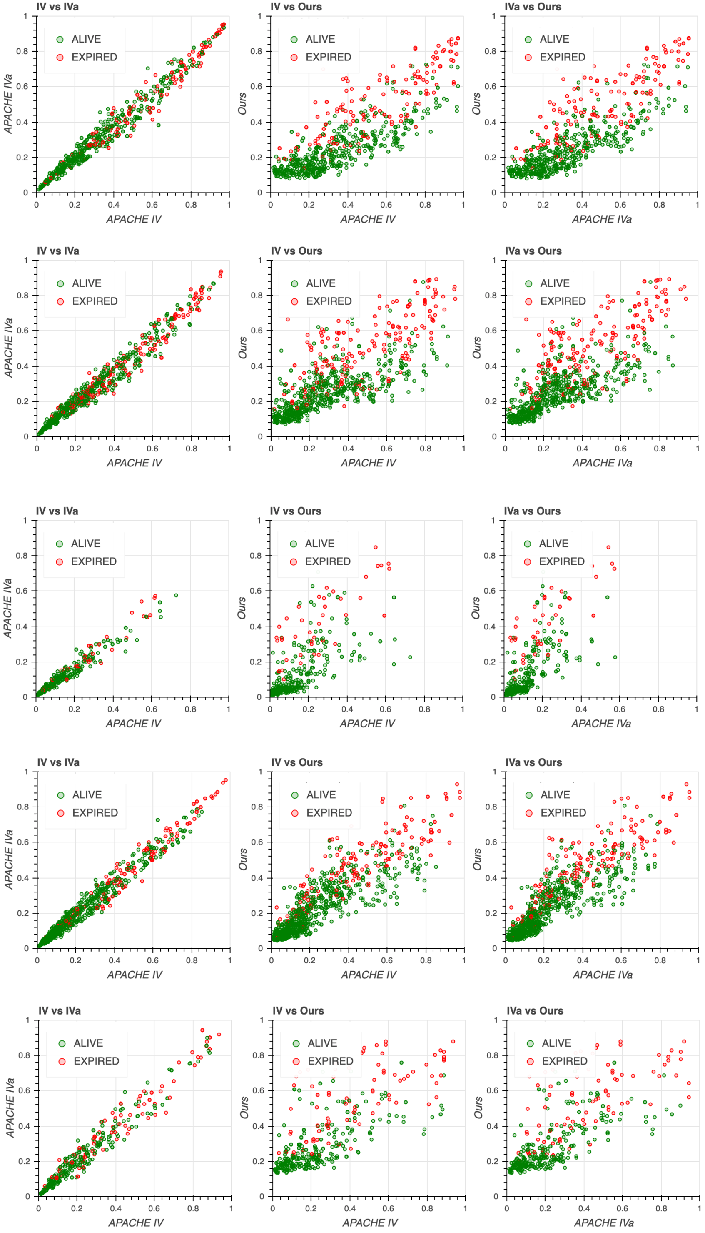
Figure S2
Subgroup #1
Subgroup #2
Subgroup #3
Subgroup #4
Subgroup #5

Slide 3
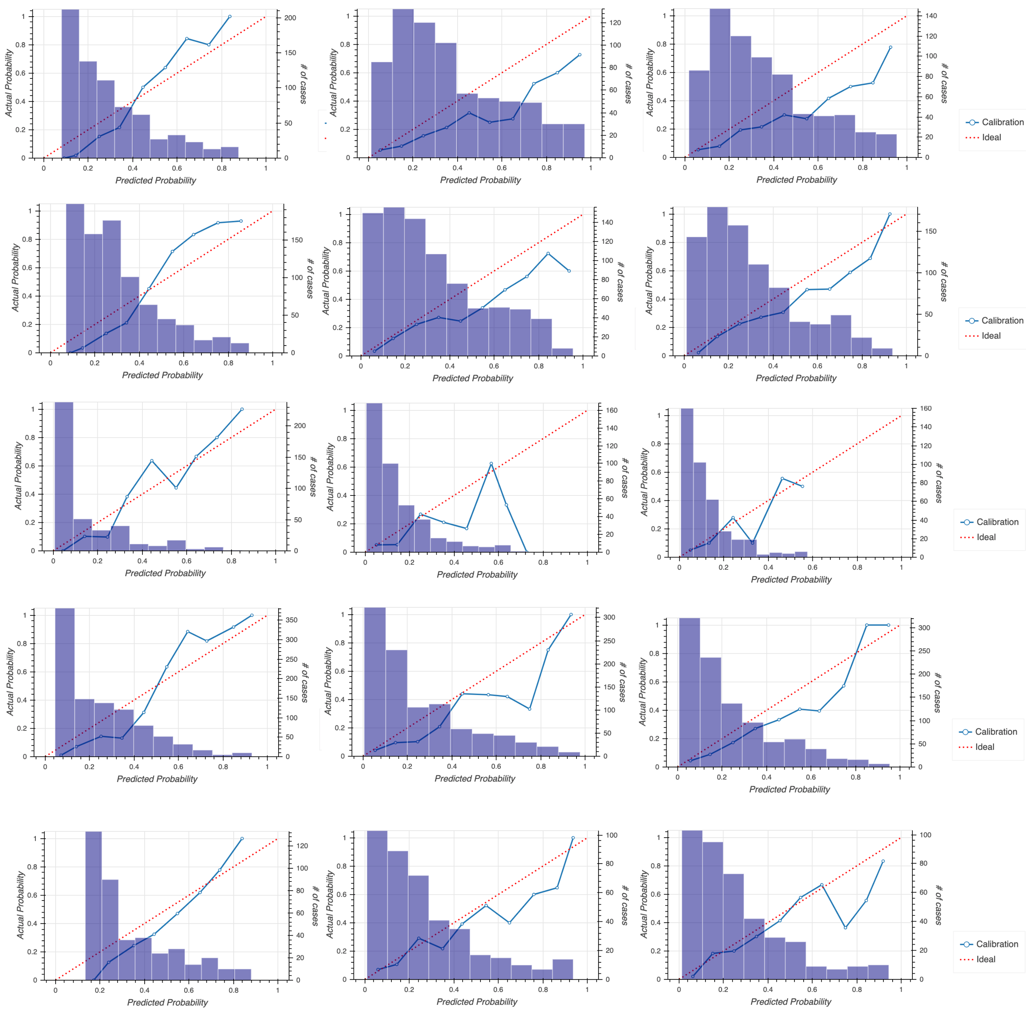
Figure S3
Ours
APACHE IV
APACHE IVa
Subgroup #1
Subgroup #2
Subgroup #3
Subgroup #4
Subgroup #5

Slide 4
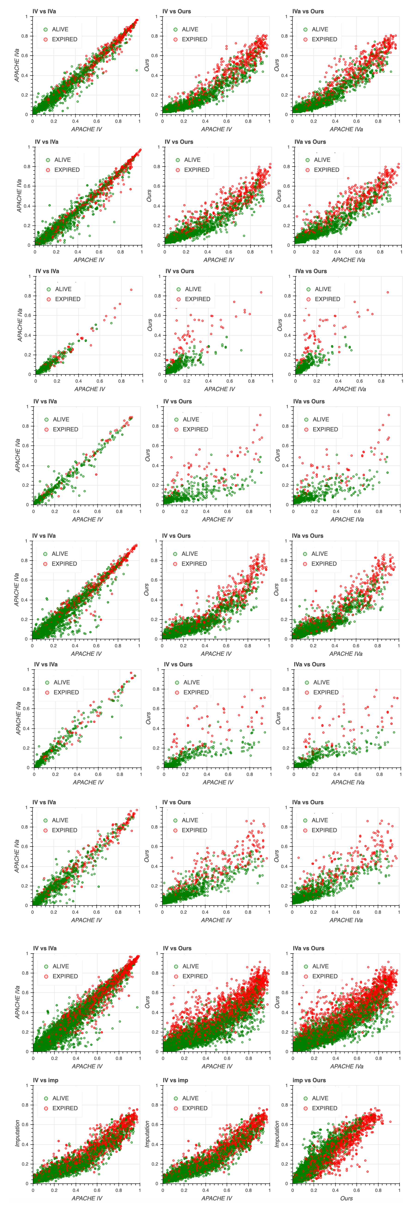
Figure S4
Subgroup #1
Subgroup #2
Subgroup #3
Subgroup #4
Subgroup #5
Subgroup #6
Subgroup #7
Integrated
Imputation

Slide 5
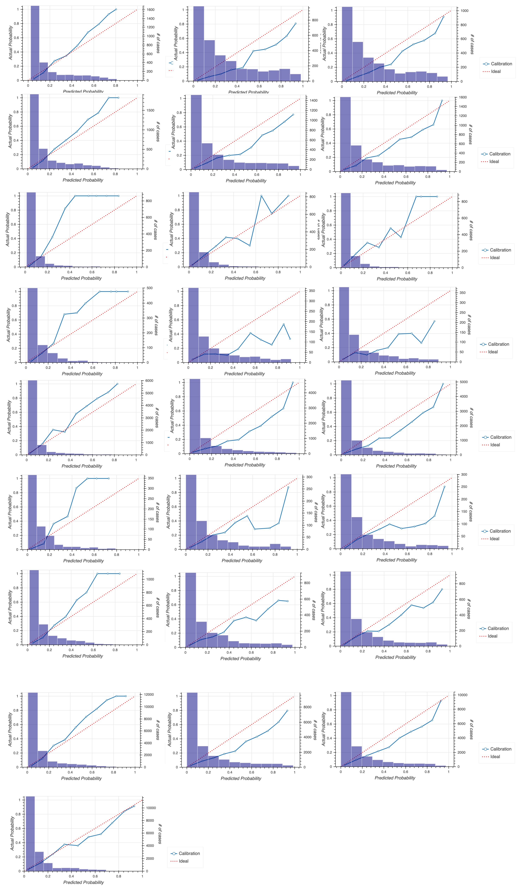
Figure S5
Ours
APACHE IV
APACHE IVa
Subgroup #1
Subgroup #2
Subgroup #3
Subgroup #4
Subgroup #5
Subgroup #6
Subgroup #7
Integrated
Imputation

