Slide 1
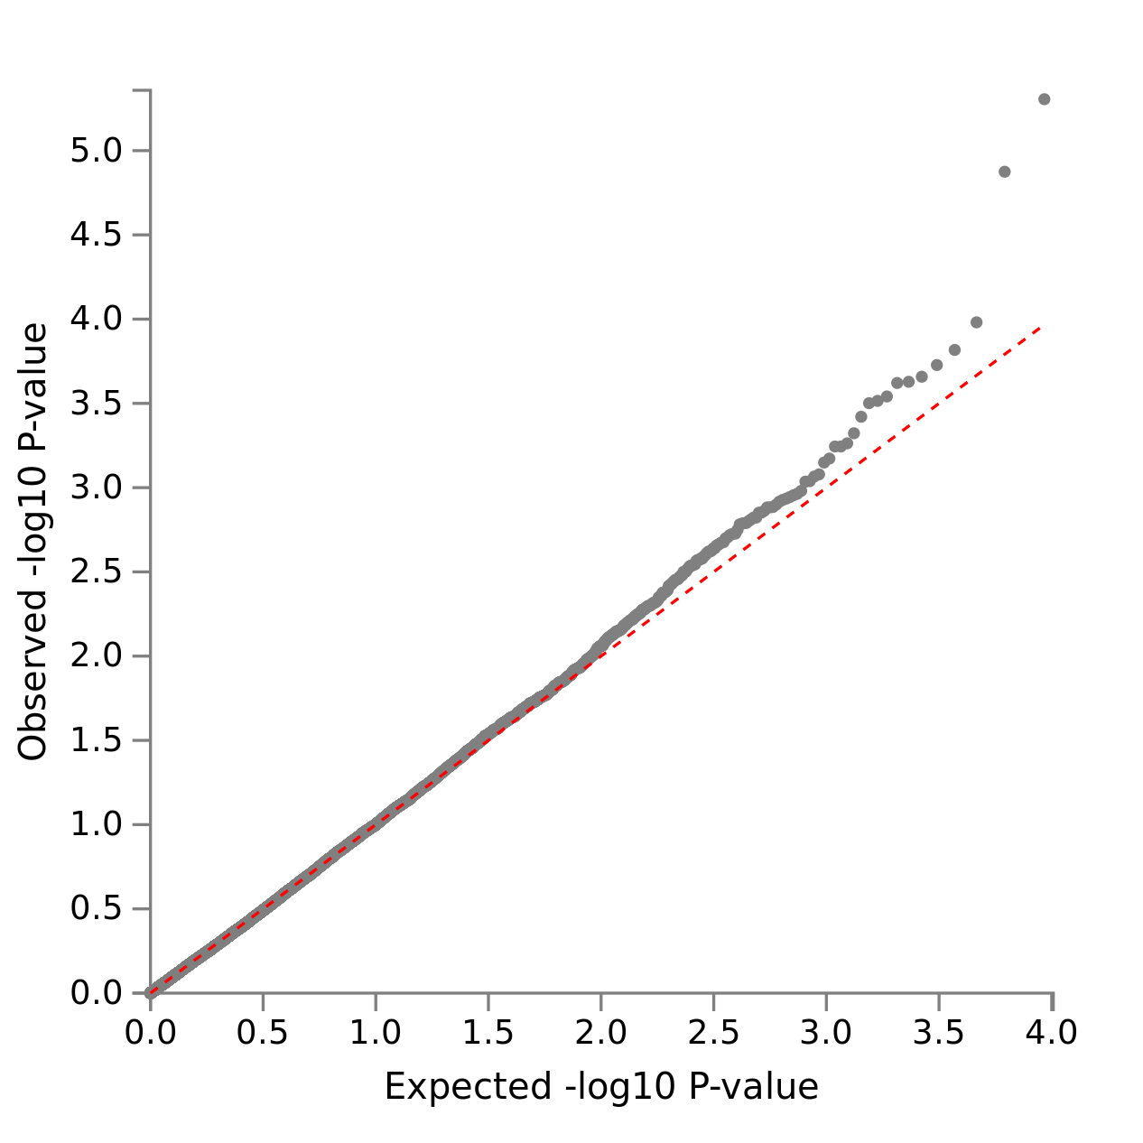
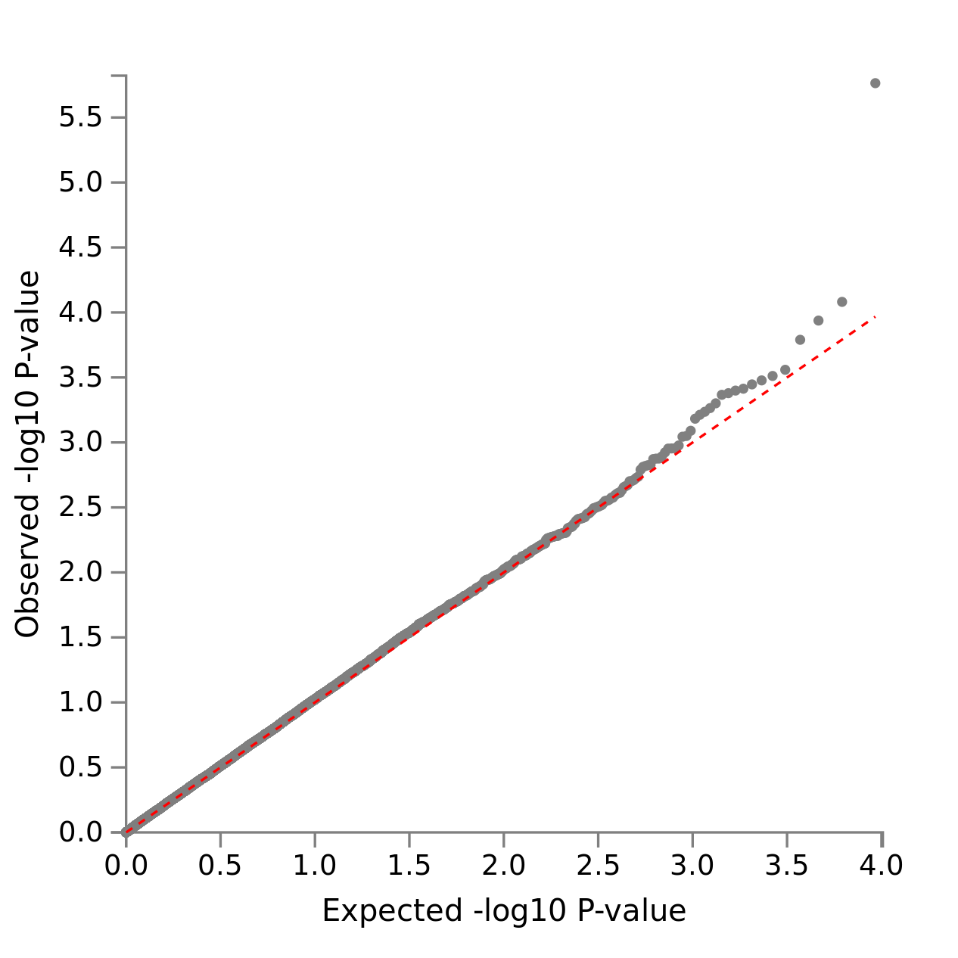
A)
APE Domain Cognitive Performance: Gene X Cancer Case/Control
B)
LM Domain Cognitive Performance: Gene X Cancer Case/Control

