Slide 1
Supplementary material
ss-2D images and vol-3D videos* of voxel-wise ΔR₁ maps for all 12 pregnant subjects.
*run as slideshow and click right-hand side image to play video

Slide 2
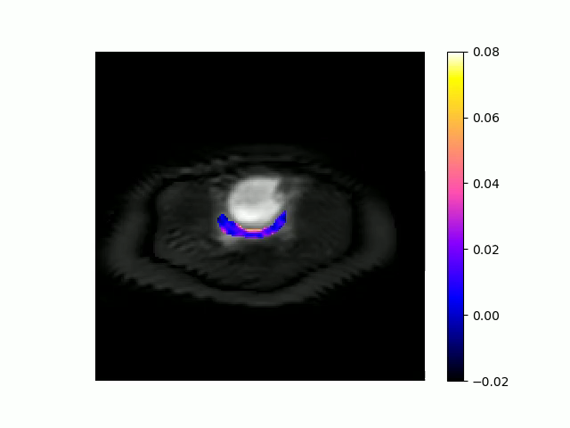
Subject 1
ss2D
vol3D

Slide 3
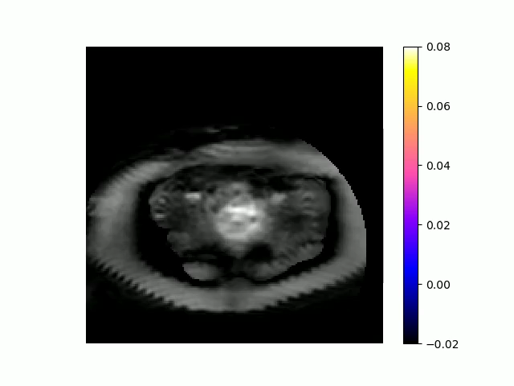
Subject 2
ss2D
vol3D

Slide 4
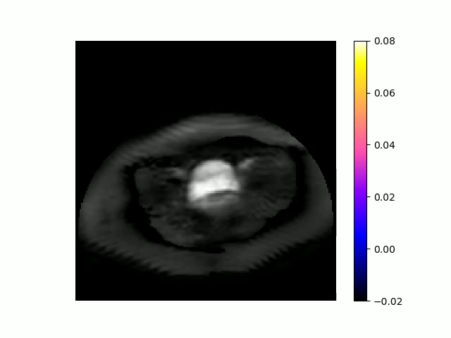
Subject 3
ss2D
vol3D

Slide 5
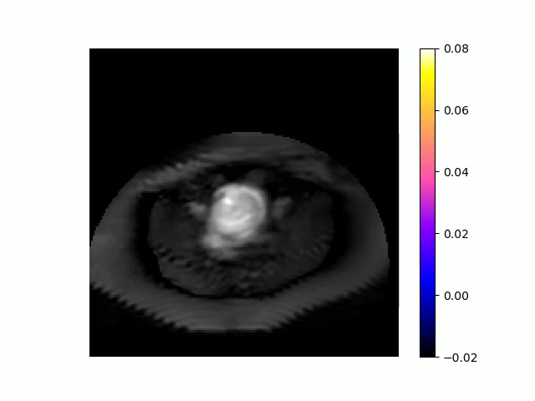
Subject 4
ss2D
vol3D

Slide 6
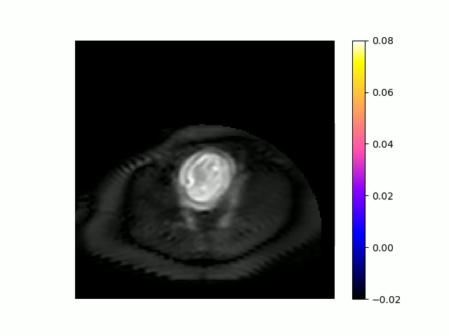
Subject 5
ss2D
vol3D

Slide 7
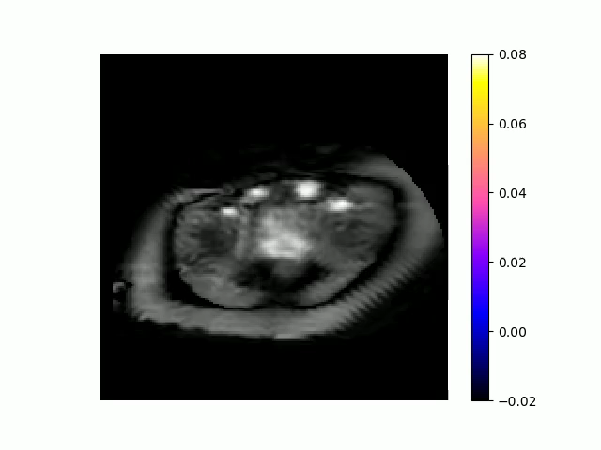
Subject 6
ss2D
vol3D

Slide 8
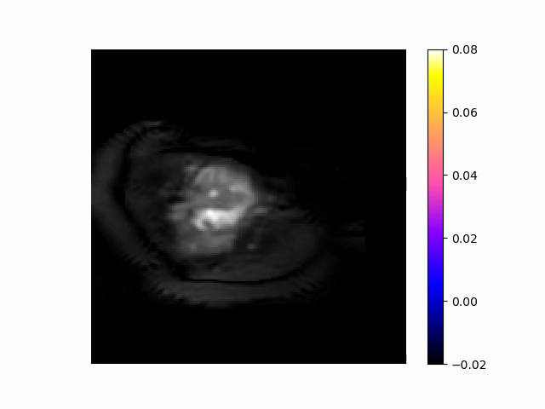
Subject 7
ss2D
vol3D

Slide 9
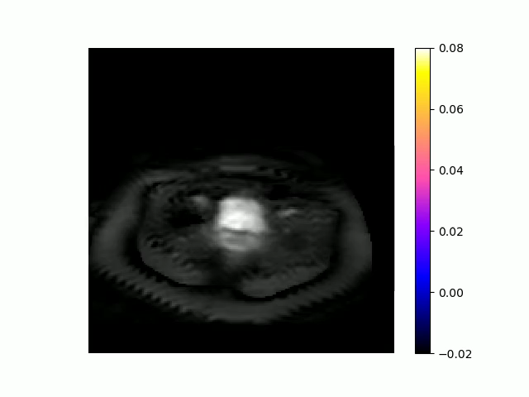
Subject 8
ss2D
vol3D

Slide 10
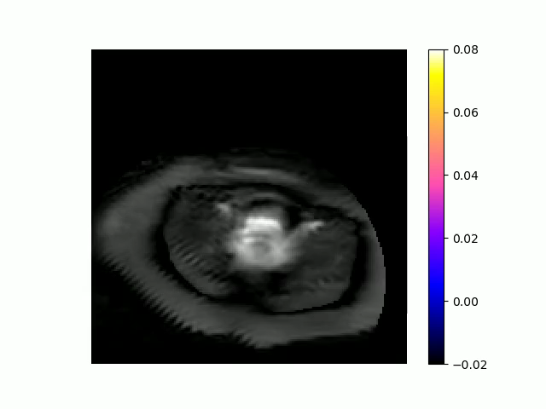
Subject 9
ss2D
vol3D

Slide 11
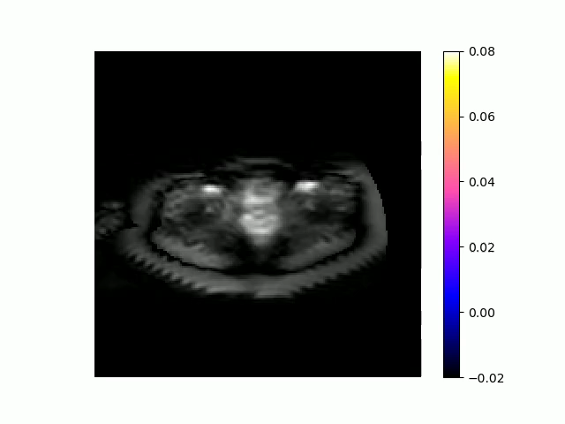
Subject 10
ss2D
vol3D

Slide 12
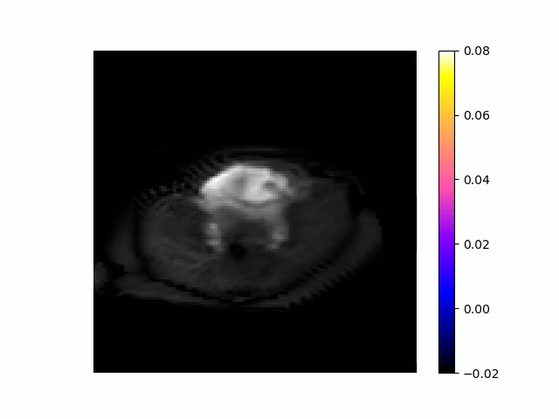
Subject 11
ss2D
vol3D

Slide 13

Subject 12
ss2D
vol3D

