Slide 1
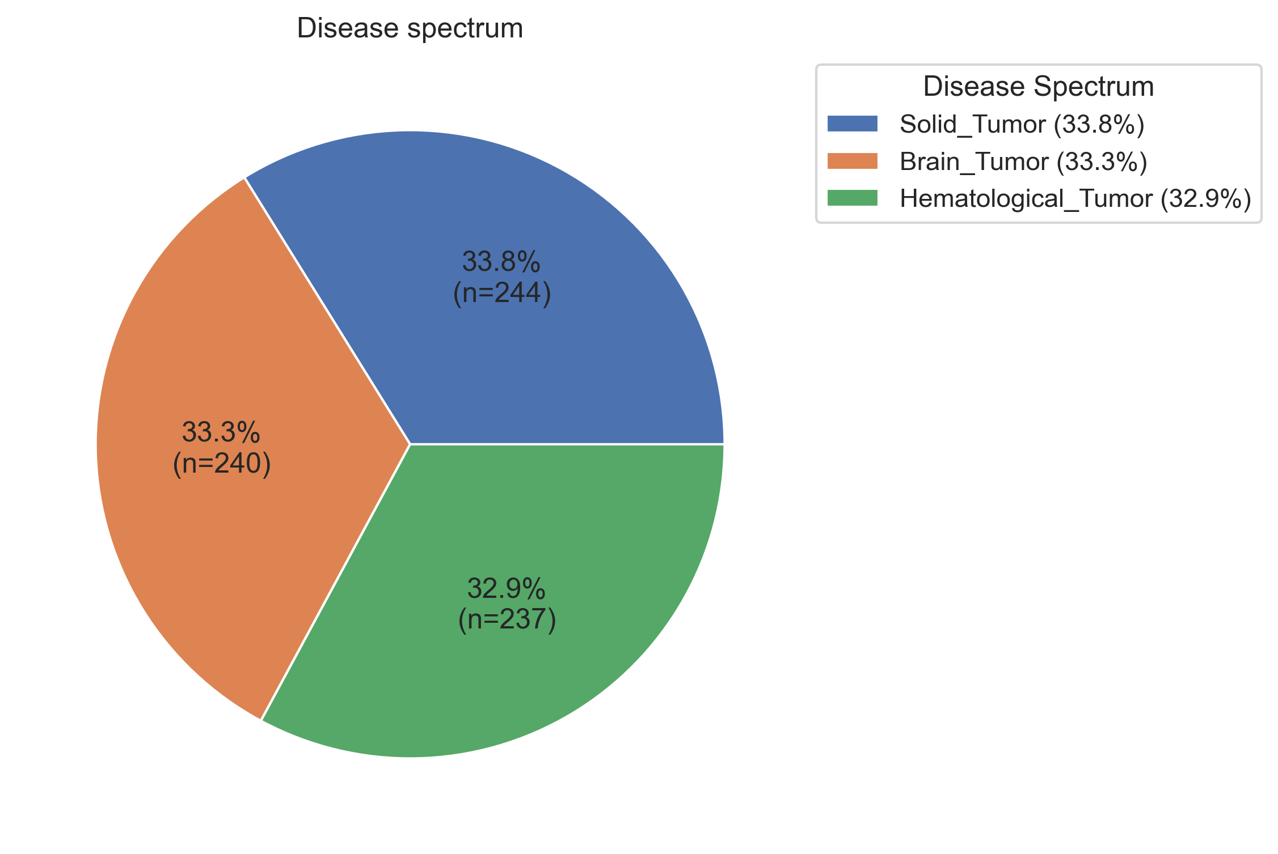
Supplementary Figure 1.
Notes:
Supplementary Figure 1.

Slide 2
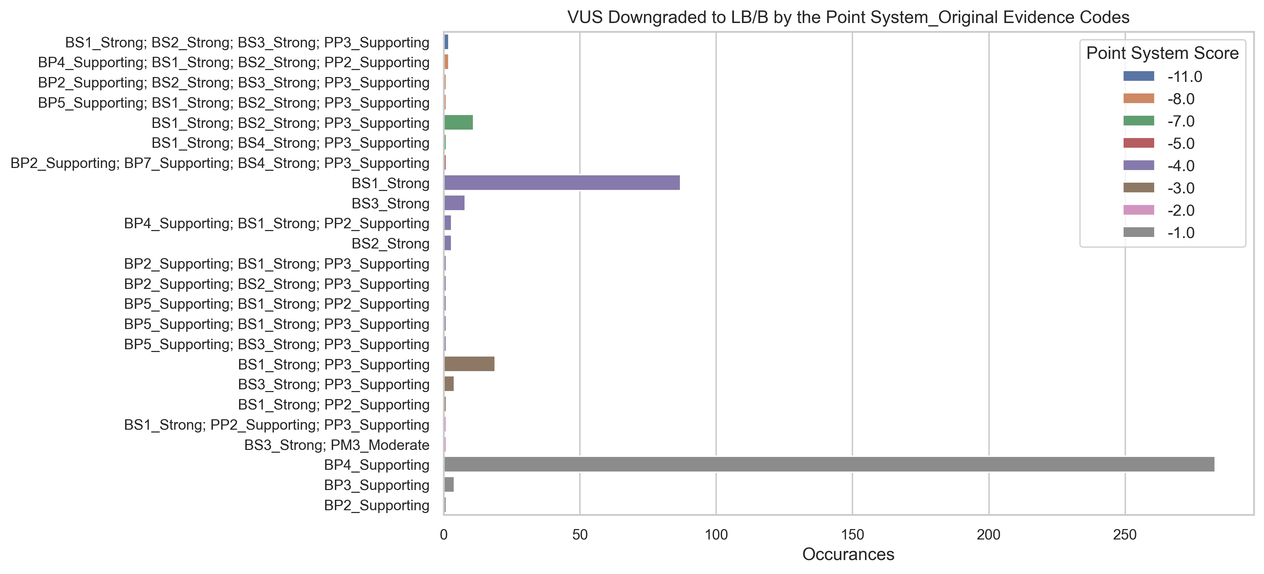
Supplementary Figure 2.
Notes:
Supplementary Figure 2.

Slide 3
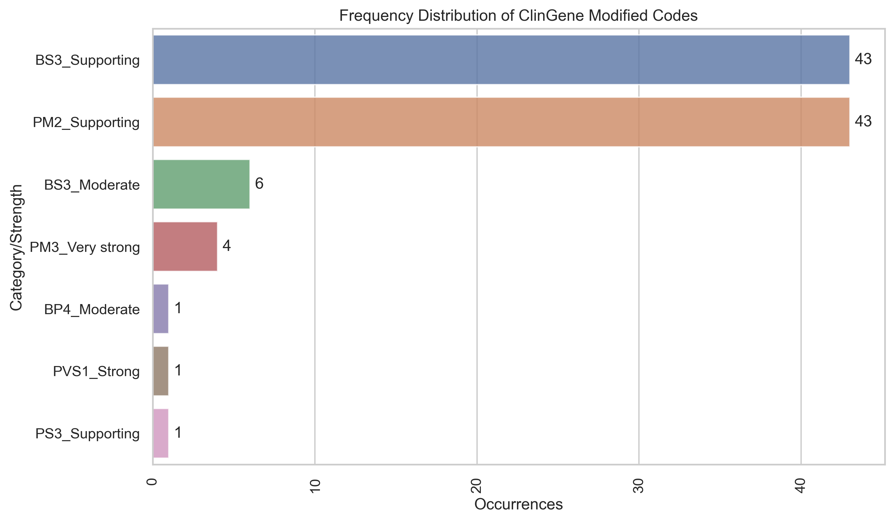
Supplementary Figure 3a.
Notes:
Supplementary figure 3a.

Slide 4
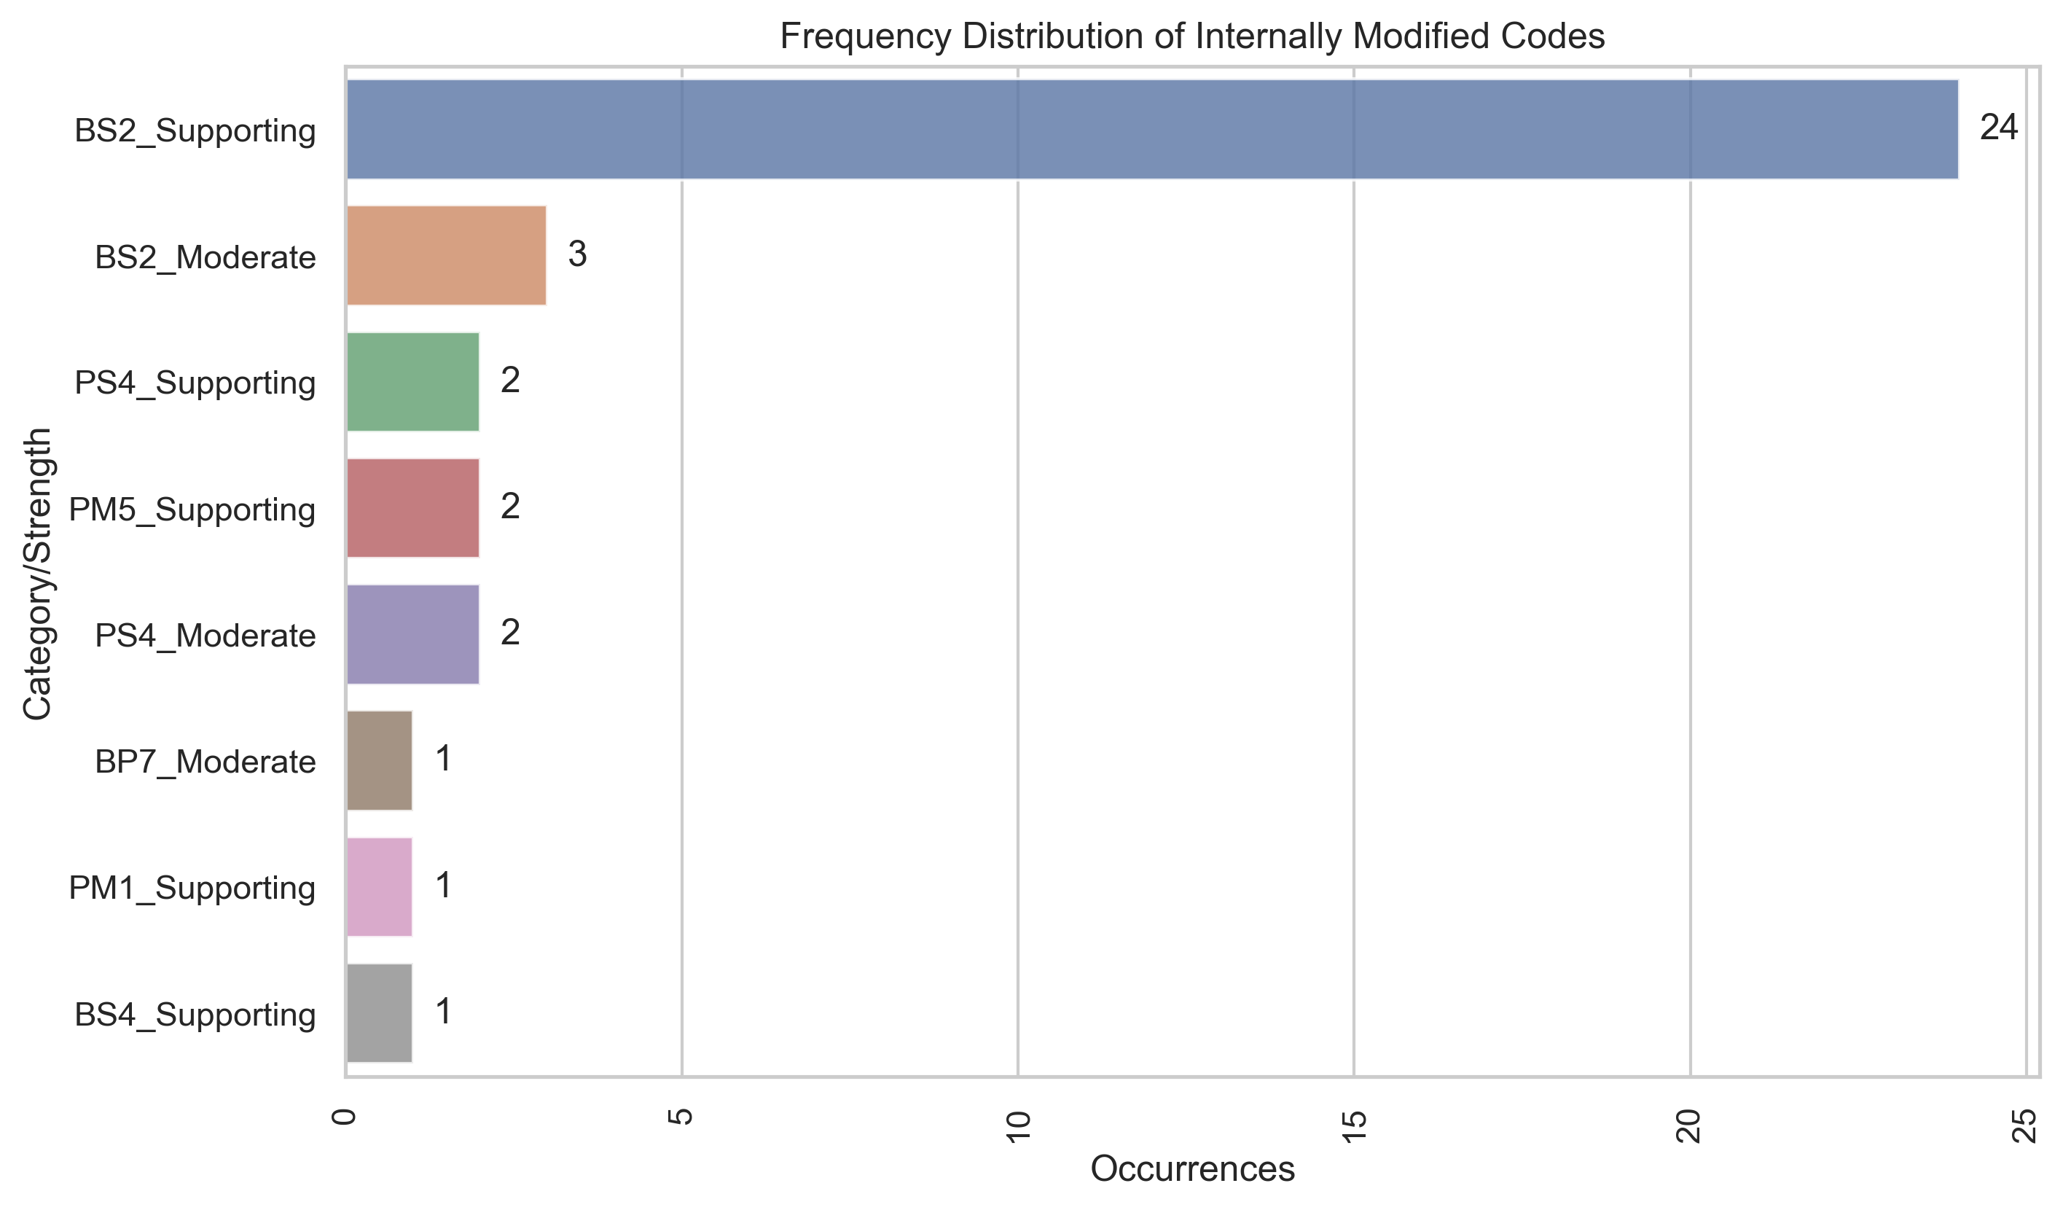
Supplementary Figure 3b.
Notes:
Supplementary figure 3b.

Slide 5
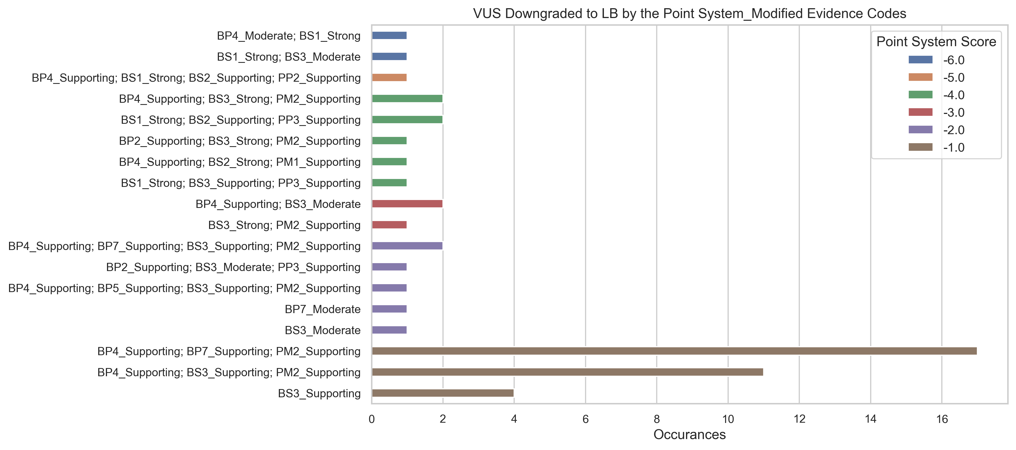
Supplementary figure 4a.
Notes:
Supplementary figure 4a.

Slide 6
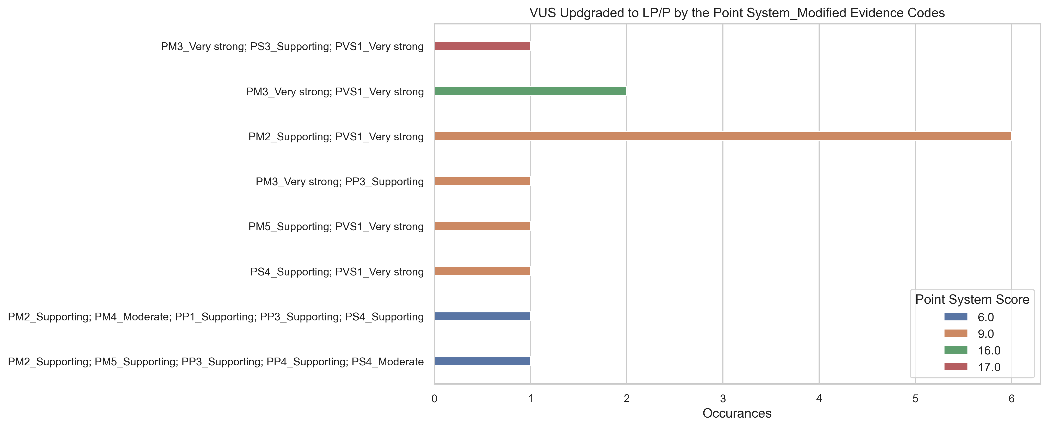
Supplementary Figure 4b.
Notes:
Supplementary figure 4b.

Slide 7
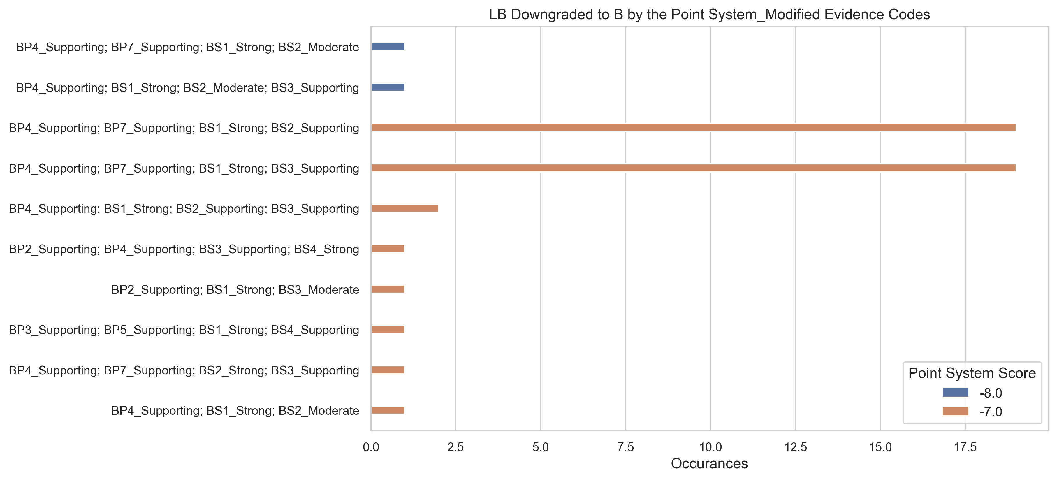
Supplementary Figure 4c.
Notes:
Supplementary figure 4c.

