Slide 1
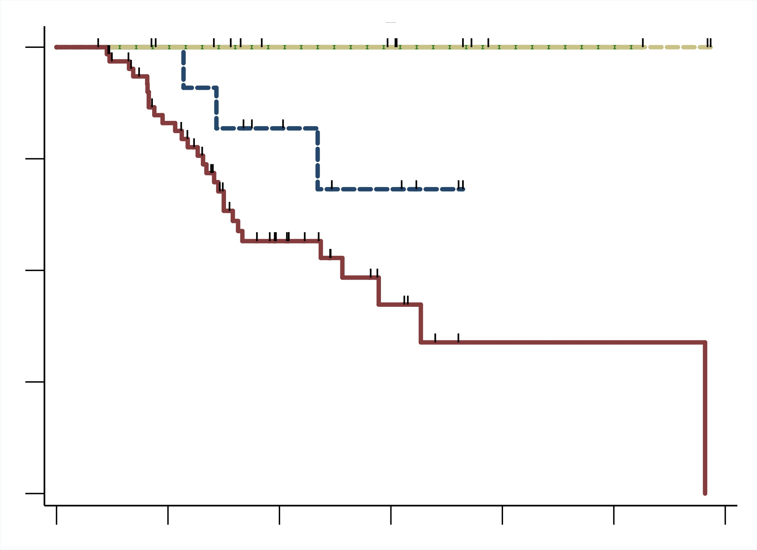
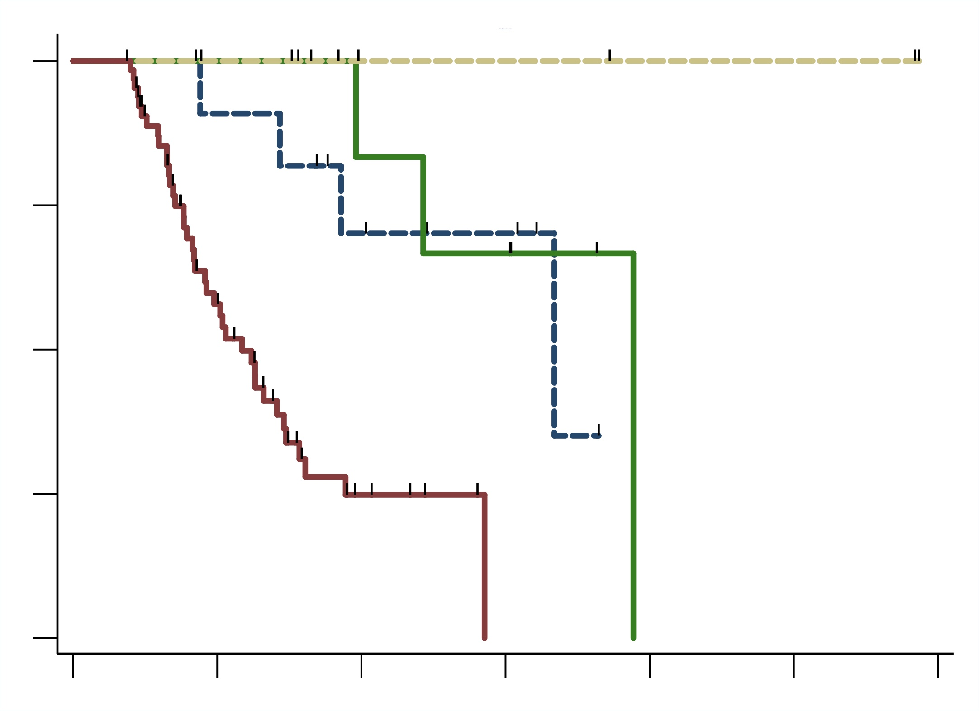
A
B
 | Median, mo (95% C.I.) | p
irAE | N.R. (N.R.) | 0.011
Medical | N.R. (N.R.) | 0.010
Preference | N.R. (8.6 – N.R.) | 0.133
Std | 15.4 (9.0 – N.R.)
 | Median, mo (95% C.I.) | p
irAE | 23.3 (11.8 – N.R.) | 0.002
Medical | N.R. (N.R.) | 0.002
Preference | 20.0 (8.6 – N.R.) | 0.003
Std | 7.0 (5.1 – 8.8)
100
irAE
100
Non-irAE Medical
Non-irAE Medical
75
Preference
75
Preference
50
50
irAE
Overall Survival
(percentage)
Standard
Progression-Free Survival
(percentage)
25
25
Standard
0
0
0
6
12
18
24
30
36
0
6
12
18
24
30
36
Time since start of pembrolizumab
(months)
Time since start of pembrolizumab
(months)
No. at risk:
irAE
Medical
Preference
Std
No. at risk:
irAE
Medical
Preference
Std
9 | 8 | 6 | 5 | 1 | 1 | 0
7 | 6 | 4 | 4 | 2 | 2 | 0
11 | 11 | 7 | 4 | 0 | 0 | 0
65 | 47 | 20 | 7 | 1 | 1 | 0
9 | 8 | 5 | 4 | 0 | 0 | 0
7 | 6 | 3 | 3 | 2 | 2 | 0
11 | 10 | 6 | 4 | 0 | 0 | 0
65 | 29 | 5 | 0 | 0 | 0 | 0

