Slide 1
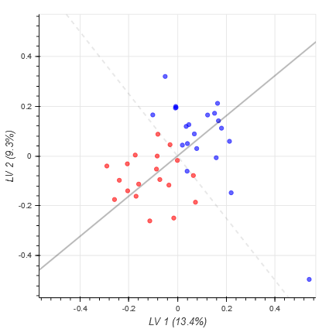
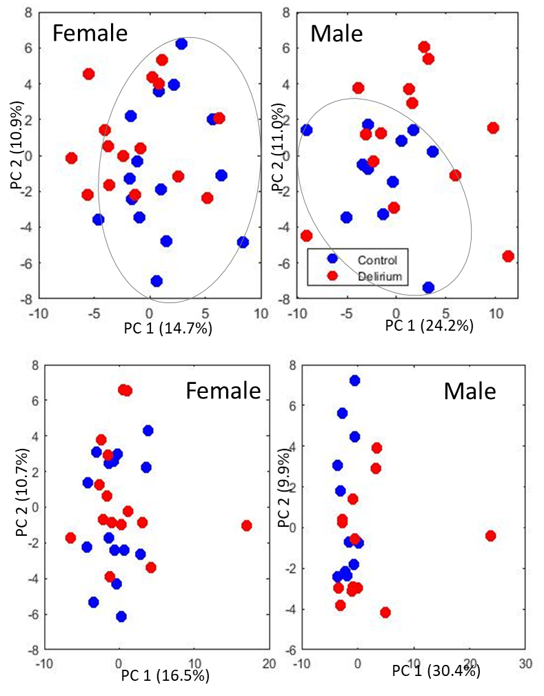
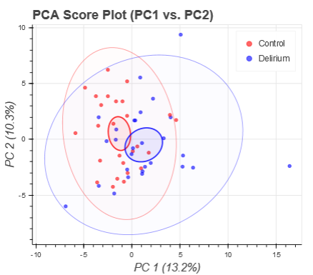
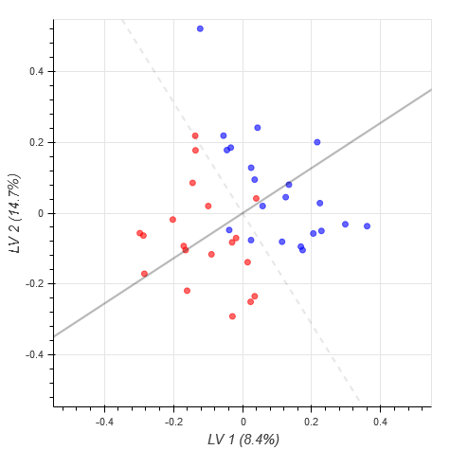
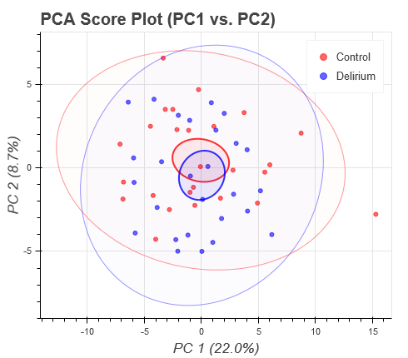
E
A
Control
Delirium
C
PC 2 (10.3%)
LV 2 9.7%)
F
CSF
CSF
PC 1 (13.2%)
LV 1 (13.4%)
B
D
PC 2 (8.7%)
LV 14.7%)
Supplementary Figure 1. Samples separation by preoperative metabolic profiles in control and post-operative delirium groups with unsupervised PCA analysis in CSF (A) and Blood (B) as well as supervised PLS-DA analysis in CSF (C) and blood (D). (E) and (F) PCA of samples from blood and CSF for all patients and divided by gender. Performed using Matlab and following sample scaling. Separation of delirium-prone and controls patients is more significate in PC1 when analyzing separately for male and female patients.
Blood
Blood
PC 1 (22.0%)
LV 1 (8.4%)

Slide 2
C0
C10
C10-1
C10-2
C12
C12-DC
C12-1
C14
C14-1-OH
C14-2
C14-2-OH
C16-1-OH
C16-2
C16-2-OH
C18-2
C2
C3
C3-DC_(C4-OH)
C4
C6_(C4-1-DC)
C5
C5-M-DC
C5-OH_(C3-DC-M)
C5-DC_(C6-OH)
C7-DC
C8
Ala
Arg
Asn
Asp
Cit
Gln
Glu
Gly
His
Ile
Leu
Lys
Met
Orn
Phe
Pro
Ser
Thr
Trp
Tyr
Val
ADMA
Creatinine
Kynurenine
Met-SO
PEA
Putrescine
Spermidine
Spermine
t4-OH-Pro
Taurine
SDMA
lysoPC_a_C14-0
lysoPC_a_C20-3
PC_aa_C24-0
PC_aa_C26-0
PC_aa_C30-0
PC_aa_C32-0
PC_aa_C32-1
PC_aa_C34-1
PC_aa_C34-2
PC_aa_C36-0
PC_aa_C36-1
PC_aa_C36-2
PC_aa_C36-3
PC_aa_C36-4
PC_aa_C38-3
PC_aa_C38-4
PC_aa_C38-5
PC_aa_C38-6
PC_aa_C40-1
PC_aa_C40-4
PC_aa_C40-5
PC_aa_C40-6
PC_aa_C42-6
PC_ae_C30-0
PC_ae_C32-1
PC_ae_C34-0
PC_ae_C34-1
PC_ae_C34-2
PC_ae_C36-1
PC_ae_C36-2
PC_ae_C36-3
PC_ae_C36-4
PC_ae_C36-5
PC_ae_C38-0
PC_ae_C38-4
PC_ae_C38-5
PC_ae_C42-0
PC_ae_C42-1
PC_ae_C42-5
PC_ae_C44-5
SM_C16-0
SM_C18-0
H1
a-beta
C0
C10
C10:1
C10:2
C12
C12-DC
C12:1
C14
C14:1-OH
C14:2
C14:2-OH
C16:1-OH
C16:2
C16:2-OH
C18:2
C2
C3
C3-DC (C4-OH)
C4
C6 (C4:1-DC)
C5
C5-M-DC
C5-OH (C3-DC-M)
C5-DC (C6-OH)
C7-DC
C8
Ala
Arg
Asn
Asp
Cit
Gln
Glu
Gly
His
Ile
Leu
Lys
Met
Orn
Phe
Pro
Ser
Thr
Trp
Tyr
Val
ADMA
Creatinine
Kynurenine
Met-SO
PEA
Putrescine
Spermidine
Spermine
t4-OH-Pro
Taurine
SDMA
lysoPC a C14:0
lysoPC a C20:3
PC aa C24:0
PC aa C26:0
PC aa C30:0
PC aa C32:0
PC aa C32:1
PC aa C34:1
PC aa C34:2
PC aa C36:0
PC aa C36:1
PC aa C36:2
PC aa C36:3
PC aa C36:4
PC aa C38:3
PC aa C38:4
PC aa C38:5
PC aa C38:6
PC aa C40:1
PC aa C40:4
PC aa C40:5
PC aa C40:6
PC aa C42:6
PC ae C30:0
PC ae C32:1
PC ae C34:0
PC ae C34:1
PC ae C34:2
PC ae C36:1
PC ae C36:2
PC ae C36:3
PC ae C36:4
PC ae C36:5
PC ae C38:0
PC ae C38:4
PC ae C38:5
PC ae C42:0
PC ae C42:1
PC ae C42:5
PC ae C44:5
SM C16:0
SM C18:0
H1
A
B
Supplementary Figure 2. Coefficient plot for PLS-DA, supervised classification of delirium and control patient groups in CSF (A) and blood (B).

Slide 3
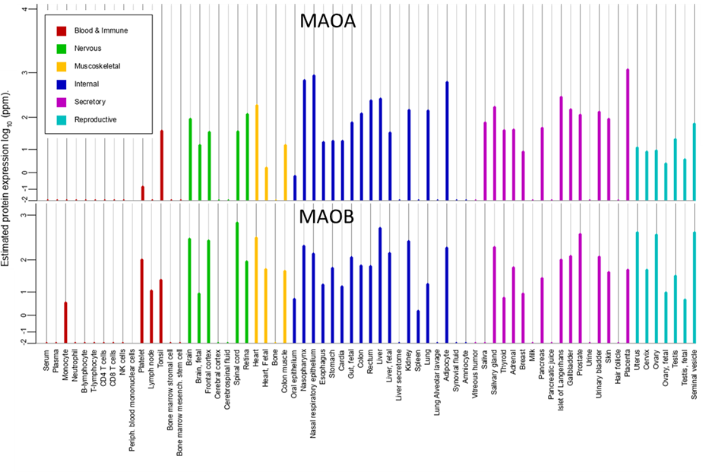
Supplementary Figure 3. Protein expression levels for MAOA and MAOB obtained from https://www.genecards.org/.

Slide 4
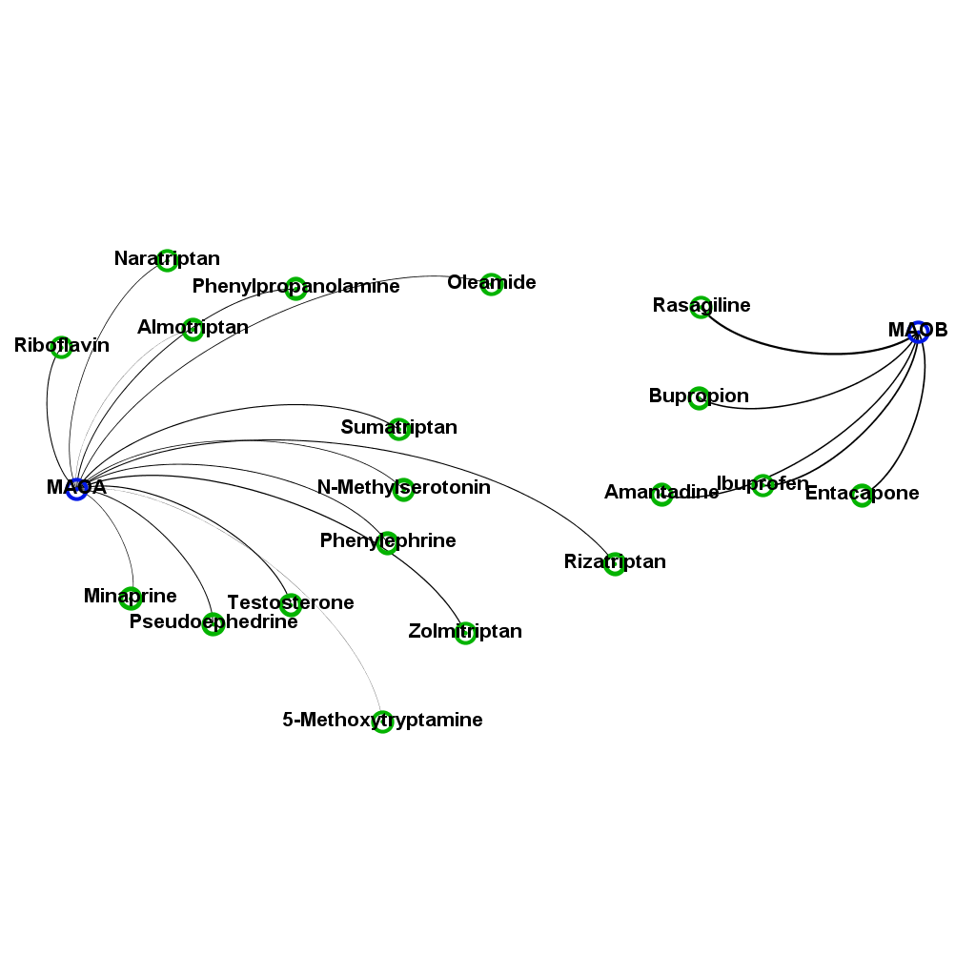
Metabolites related to MAOA and MAOB through analysis of Brenda and HMDB databasese
1-Methylhistamine
1-Phenylethylamine
3,4-Dihydroxymandelaldehyde
3,4-Dihydroxyphenylacetaldehyde
3-Hydroxykynurenamine
3-Methoxy-4-hydroxyphenylglycolaldehyde
3-Methoxytyramine
4,6-Dihydroxyquinoline
4-Hydroxyphenylacetaldehyde
5-Hydroxyindoleacetaldehyde
5-Hydroxykynurenamine
Aminoacetone
Ammonia
Citalopram
Citalopram aldehyde
Didemethylcitalopram
Dimethylamine
Dopamine
Epinephrine
FAD
Furazolidone
Homovanillin
Hydrogen peroxide
Imipramine
Indoleacetaldehyde
Isocarboxazid
Linezolid
Metanephrine
Methamphetamine
Methylamine
Methylimidazole acetaldehyde
Moclobemide
N4-Acetylaminobutanal
N-Acetylputrescine
Nandrolone decanoate
N-Desmethylcitalopram
Nicotine
Norepinephrine
Normetanephrine
Oxygen
Pargyline
Phenelzine
Phentermine
Phenylacetaldehyde
Pyruvaldehyde
Quinoline-4,8-diol
Selegiline
Serotonin
Tranylcypromine
Tryptamine
Tyramine
Zonisamide
Supplementary Figure 4. List of metabolites related to MAOA and MAOB through known interactions or enzymatic reactions. Shown are only direct partners.

Slide 5
HEALTHY MILD SEVERE
Supplementary Figure 5.
SAM determination of significantly differentially concentrated metabolites between healthy and covid-19 infected subjects based on data provided by Shen, 2020
-2 0 2

Slide 6
ACE2
MAOB

Slide 7
MOAO
ACE2
Spike protein
Supplementary Figure 6. Comparison between X-ray structure off MOAO (PDB: 1GOS) and ACE2-Spike protein (PDB: 6M0J)

Slide 8
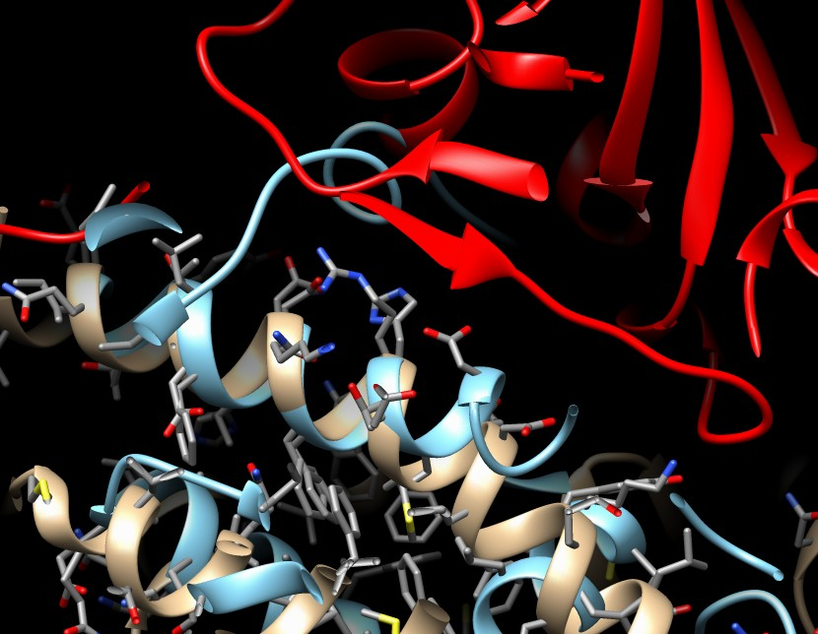
D30
H34
K31
Supplementary Figure 8. Comparison between X-ray structure off MOAO (PDB: 1GOS) and ACE2-Spike protein (PDB: 6M0J) – binding region

Slide 9
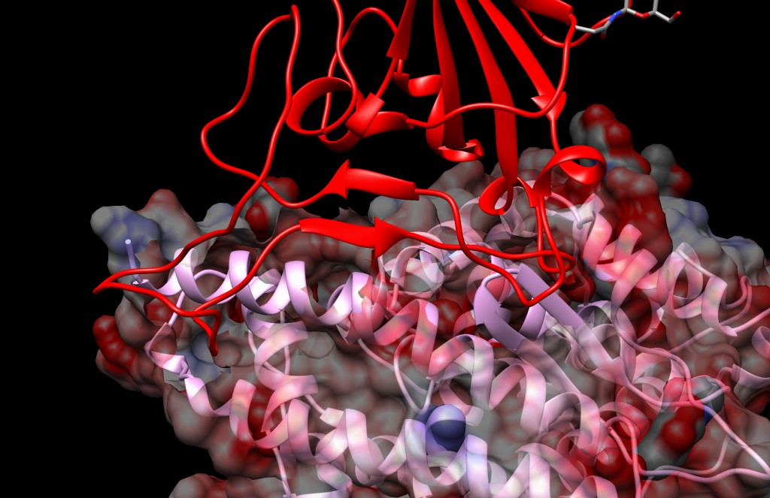
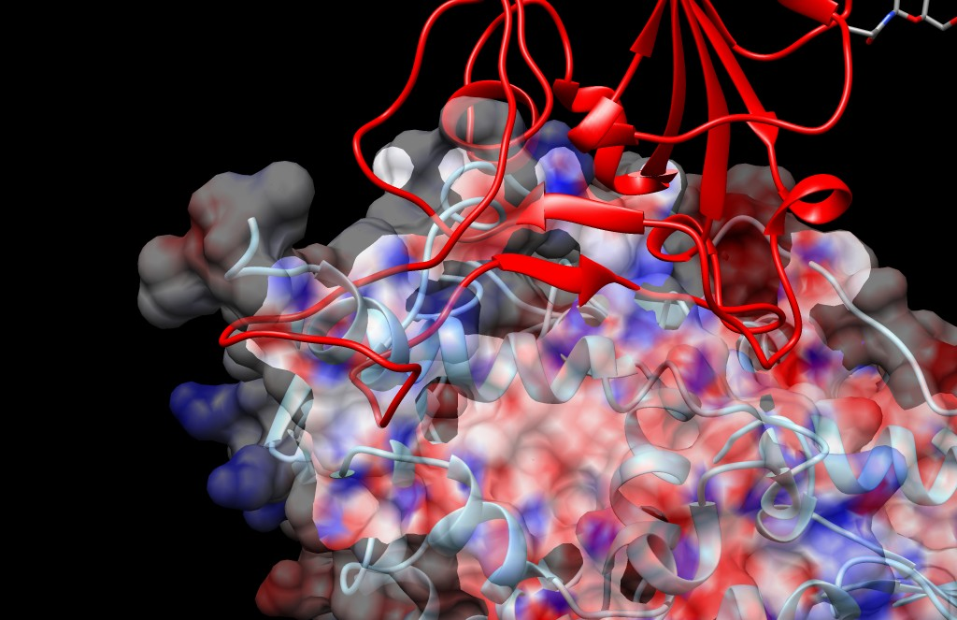
Supplementary Figure 9. Comparison between X-ray structure off MOAO (PDB: 1GOS) and ACE2-Spike protein (PDB: 6M0J) – binding region

Slide 10
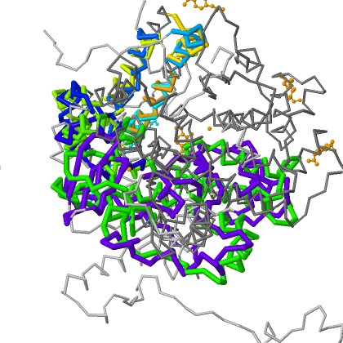
Section 1
6M0J
Similarity:100%
1GOS
Similarity:100%
P-value:1.67e-02
6M0J
Similarity:42%
1GOS
Similarity:51%
P-value:6.67e-01
Section 2
6M0J
Similarity:74%
1GOS
Similarity:100%
P-value:5.01e-01
Supplementary Figure 10. Comparison between X-ray structure off MOAO (PDB: 1GOS) and ACE2-Spike protein (PDB: 6M0J) for overall protein structures as well as binding region for ACE2 and corresponding section of MAOB

