Slide 1
Supplementary Table 1: Titers of SARS-CoV-1 and CoV-2 Nabs found in Patients with Other Viral Infections
Samples | ID50 SARS-CoV-1 | ID50 SARS-CoV-2
Other Coronaviruses (229E, HKU1, NL63, or OC42) n=7 | All <50 | All <50
Human Rhinovirus/Enterovirus n=4 | All <50 | All <50

Slide 2
Supplementary Table 2: Detectable ID50 Neutralization Across 4 Populations
Detectable ID50 SARS-CoV-2 Neutralization Titers by Population and Symptom Severity
Measure | Asymptomatic n=12 | Mild n=21 | Admitted n=10 | SNFs n=38
Median (ID50) | 548.05 | 220.8 | 677.3 | 297.9
IQR | 234 - 6463 | 130 - 1359 | 403 - 2422 | 153 - 517

Slide 3
Supplementary Figure 1
A)
B)
C)
Supplementary Figure 1: Correlation of Commercial SARS-CoV-2 Serology Assays with Neutralization Activity.
A-C) Linear regression comparing Diazyme IgM, Diazyme IgG, Roche total Ig, and Abbott IgG Log₂ transformed values of 87 samples from 31 SARS-CoV-2 PCR confirmed patients (Y-axis) vs Log₁₀ transformed SARS-CoV-2 ID50 titers observed in the same samples (X-axis). R² values and y=mx+b equations for each regression line are shown for each assay. The value of the X-axis is set at each manufacturer's cutoff value for a seropositive SARS-CoV-2 result.

Slide 4
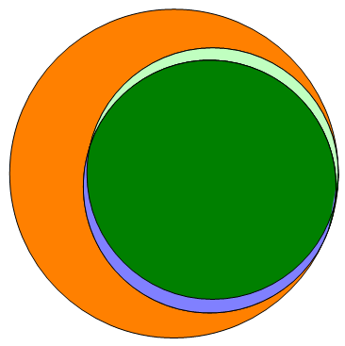
Supplementary Figure 2
Multiplatform Agreement of 164 Diazyme IgG Serpositives
Abbott IgG
(3)
Diazyme IgG
(64)
All Assays
(93)
Roche Total Ig
(4)
Supplementary Figure 2: Multiplatform Agreement of 164 Diazyme IgG Serpositives
Venn diagram illustrating the agreement of the 164 Diazyme IgG seropositive individuals with the Roche total Ig and Abbott IgG assays.

